Slide 1
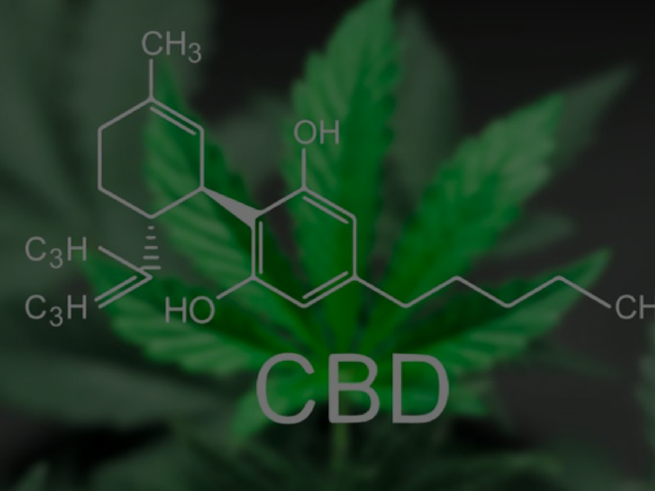
Kent Smith ASBA 2021
CBD and Sleep

Slide 2
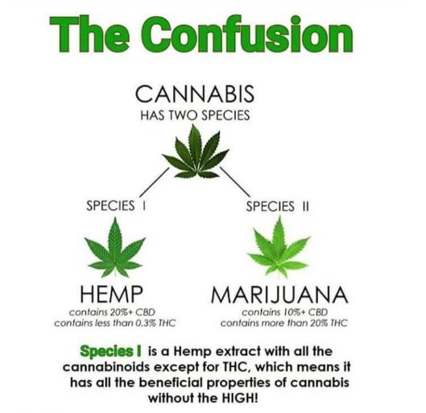
Cannabis, Hemp, Marijuana

Slide 3
Over 100 are cannabinoids
Over 480 compounds in Cannabis
Another big chunk are terpenes

Slide 4
Classes of cannabinoids
Cannabitriol (CBT) Cannabivarin (CBV) Tetrahydrocannabivarin (THCV) Cannabidivarin (CBDV) Cannabichromevarin (CBCV) Cannabigerovarin (CBGV)
Cannabigerol Monoethyl Ether (CBGM)
Cannabigerols (CBG)
Cannabichromenes (CBC)
Cannabidiols (CBD)
Tetrahydrocannabinols (THC)
Cannabinol (CBN)
Cannabinodiol (CBDL) Cannabicyclol (CBL) Cannabielsoin (CBE)

Slide 5
Over 100 Terpenes – 12 are predominant
Myrcene – musky, earthy scent – help induce sleep, analgesic
Limonene – citrus aroma – elevates mood, relieves stress
Terpinolene – nutmeg
Linalool – lavender – anti- convulsant, anti-anxiety
Pinene – pine needles – anti-inflammatory
Ocimene - mint Humulene – hops, cloves Caryophyllene – black
pepper – protects stomach
against ulceration

Slide 6
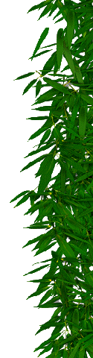
History of Cannabis
6000 BC – Cannabis seeds used as food in China
4000 BC – Textiles made of hemp in China
2727 BC – first recorded medicinal use in Chinese Pharmacopoeia
1400 BC to AD – trade moves product through India, Mediterranean countries, Europe – numerous medicinal uses reported

Slide 7
What is this drug?
Derived from a plant
Folk remedy for thousands of years before scientists realized its potential
Reduces risk of pre-eclampsia in pregnant mothers
Adjunct treatment for schizophrenia
Its broad utility explained by its anti- inflammatory effects
At low doses, reduces the risk of stroke and heart attack
?

Slide 8
Poppy flowers and opium use
How did we discover opioid receptors?
We make our own native opiods

Slide 9
Tobacco has long been used by Native Americans as a stimulant
How did we discover nicotinic receptors?
We make our own nicotinelike molecules

Slide 10
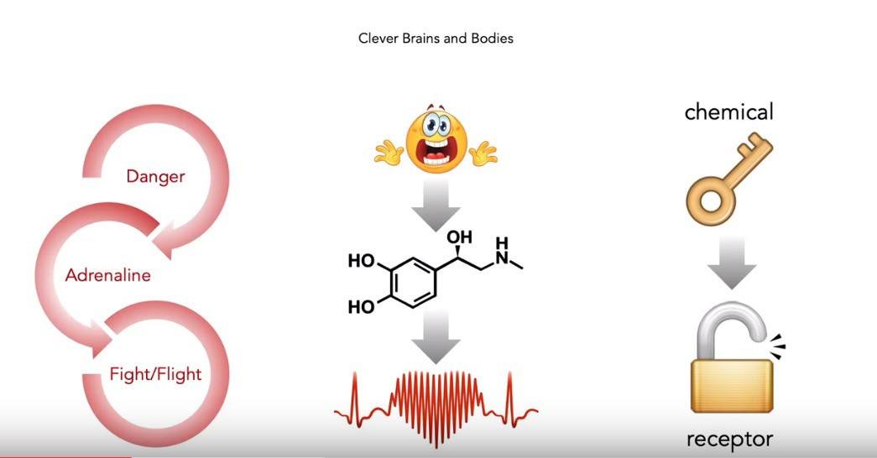
Epinephrine…

Slide 11
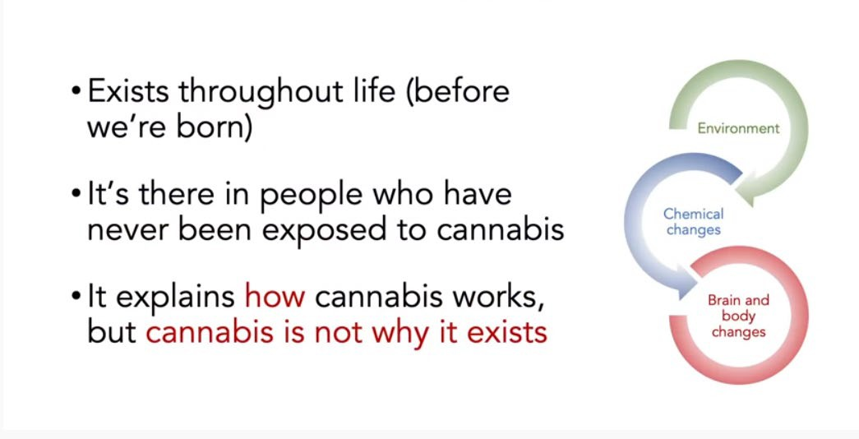
Endocannabanoid System (ECS)

Slide 12
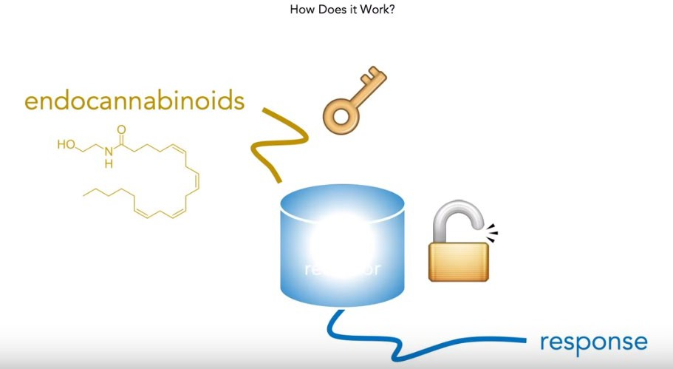
The ECS Responds

Slide 13
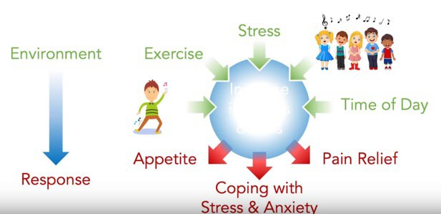
When do we make cannabinoids?

Slide 14
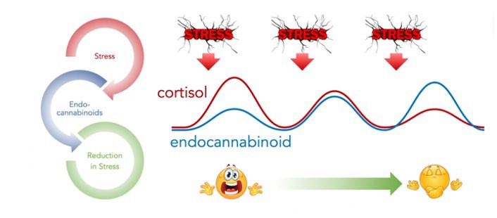
Smart System –stress

Slide 15
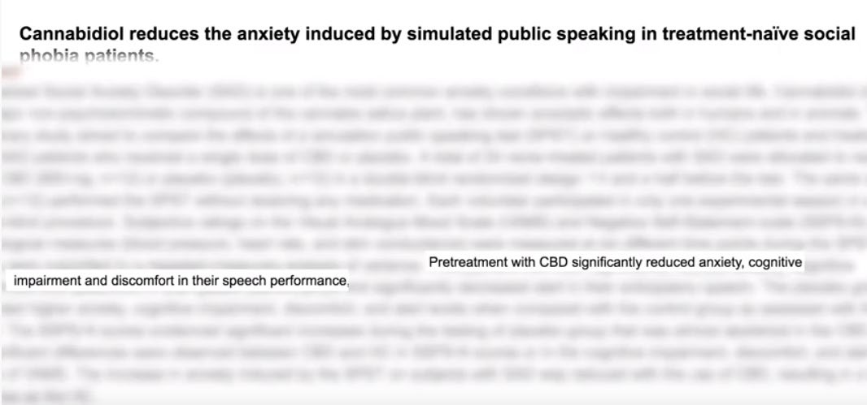
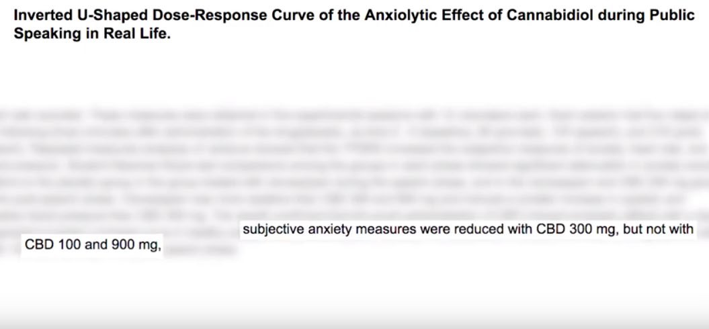
2 Studies on Anxiety and Public Speaking
CBD given to volunteers who feared public speaking
Significantly blunted the fight-or-flight response

Slide 16
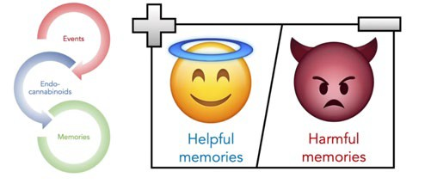
Clever System: Memories

Slide 17

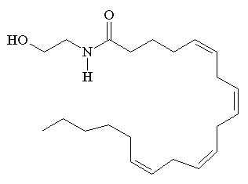
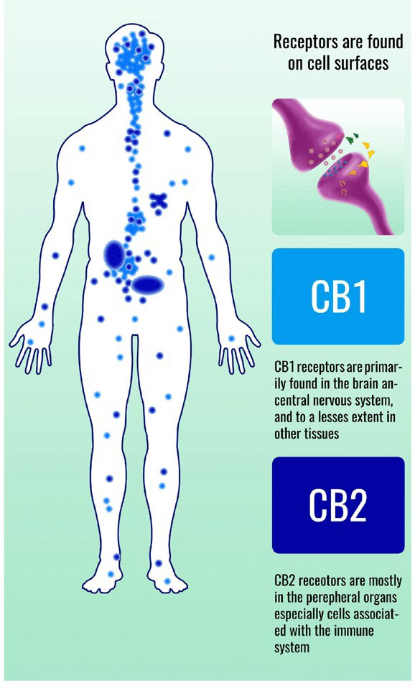
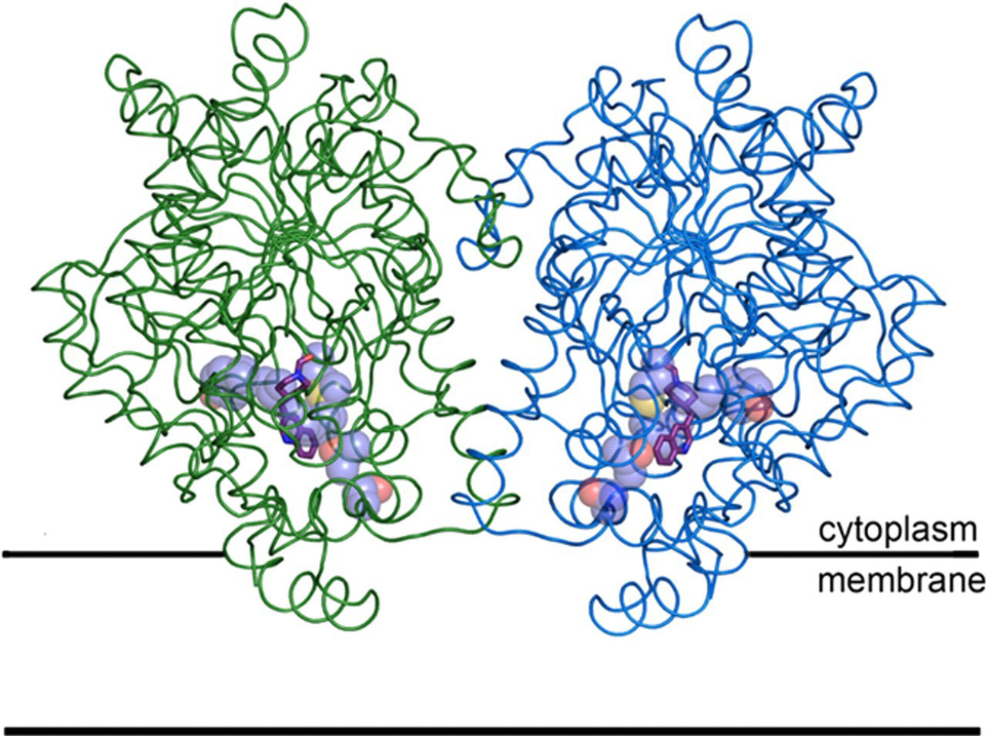
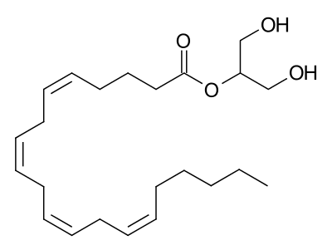
THREE COMPONENTS TO THE ECS
1. CB1 & CB2 Receptors (Targets)
2. ENDOCANNABINOIDS (Arrows)
3. ENZYMES
(Make or break the arrows)
Production: DAGL, NAPE-PLD Breakdown: Fatty Acid Amide Hydrolase (FAAH),
MAGL
Anandamide
2-AG
22. Bracey. 29 Nov 2002 Vol 298 SCIENCE. 1793-1796
10. Gonsiorek. Mol Pharmacol 2000 May;57(5): 1045-50 36. Mileni. PNAS. Vol 105: 35; 12820-4

Slide 18
Relax: physical and mental
Eat
Sleep
Forget: memory extinction, take your mind off of . .
.
Protect: metabolic
regulation, neuroprotection,, etc.
Endocannabinoid System Roles – 5 Primary Functions

Slide 19
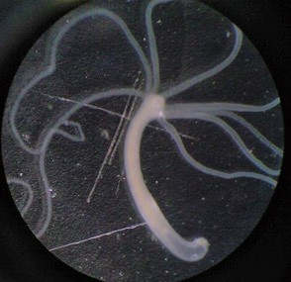
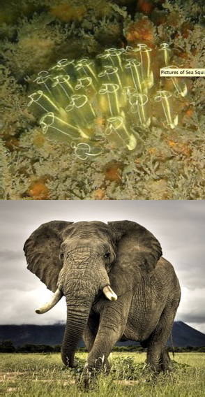
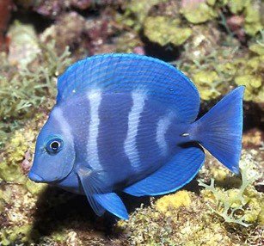
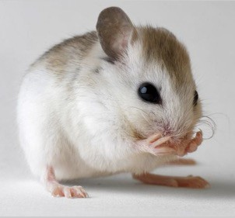

The animal kingdom is
designed with an endocannabinoid system

Slide 20
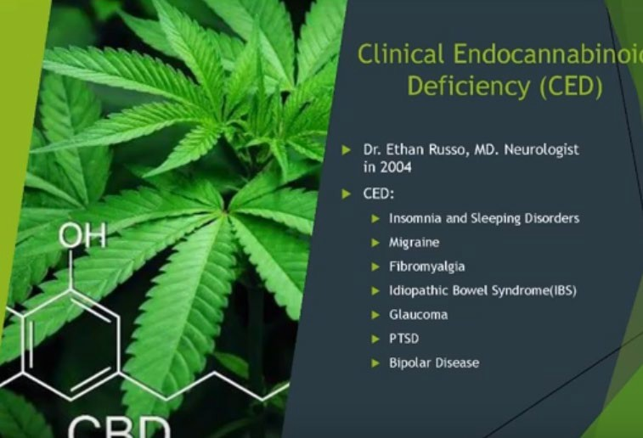

Slide 21



Varieties of Cannabinoids
Endocannabinoids
Phytocannabinoids
Synthetic cannabinoids
In your brain and body
In plants
From the lab
Anandamide, 2-AG,
Noladin ether etc.
THC, CBD, CBG, CBDV, THCV, CBC, CBN, THCVA
etc.
Nabilone, HU-210, AB- PINACA, JWH-018,
etc

Slide 22


Cannabidiol (CBD) modulates many of the effects of THC in cannabis
THC and CBD =
THC only =

Slide 23
Marijuana Contraindications
Pregnancy
Breast-feeding
Bipolar disorder
Heart disease
A weakened immune system
Allergies to fruits and vegetables
Depression
Diabetes
Liver disease
Multiple sclerosis
Lung diseases
Schizophrenia
Stroke
Surgery

Slide 24
Pregnancy and breast-feeding
CBD
Contraindications
(not enough data yet)

Slide 25
Marijuana Side Effects
Tolerance
Psychological or physical dependence
Withdrawal symptoms
Altered senses
Dizziness
Drowsiness (somnolence)
Fatigue
Reduced coordination
Cognitive impairment
Impaired balance
Euphoria
Paranoia
Hallucinations
Mood alterations
Panic
Anxiety
Low blood
pressure (hypotension)
High blood
pressure (hypertension)
Rapid heart rate (tachycardia)
Flushing
Fainting (syncope)
Dry mouth (xerostomia)
Nausea
Vomiting
Distortion of taste (dysgeusia)
Tooth discoloration
Loss of appetite
Increased appetite
Oral thrush
Diarrhea
Constipation
Urinary retention
Skin rash
Dry eyes
Blurred vision
Cough
Sore throat (pharyngitis)

Slide 26
Very few,
CBD Side Effects
but there ARE
Many Side Benefits

Slide 27
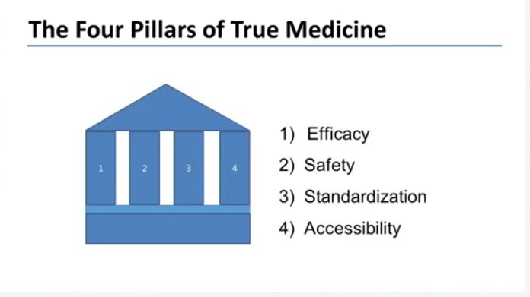

Slide 28
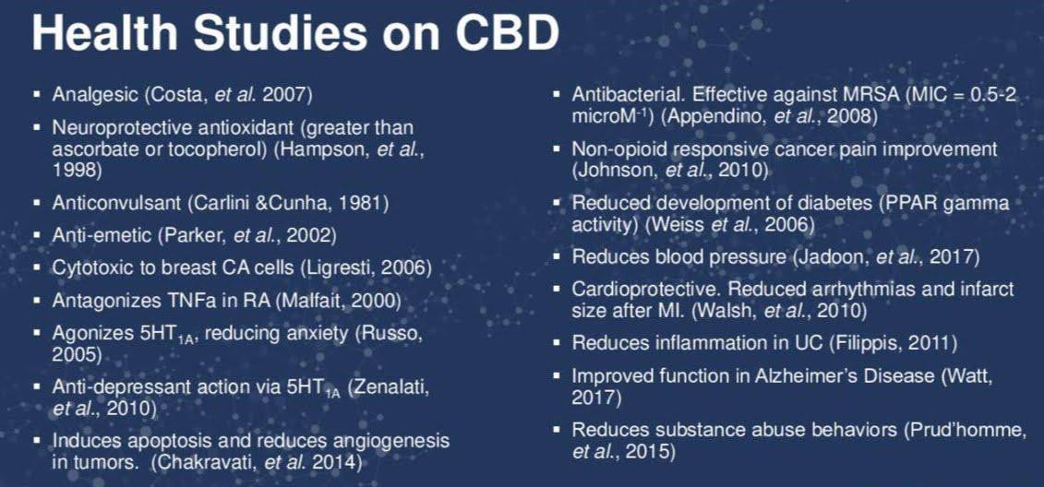

Slide 29
Yes - It has a “favorable safety profile” according to a recent article published by the National Institute of Health.
Is CBD Safe For Short- Term Use?
In comparison to other drugs used for similar treatments, its symptoms were much milder.
Occasionally there were mild side effects from intense use such as tiredness, diarrhea, and a change in appetite or weight.
These studies are ongoing but suggest that CBD is a much safer (and more natural) alternative than using other sleep aids.
Overall, it is seen as a symptomless treatment plan.

Slide 30
Unfortunately, there isn’t a ton of research available on long-term CBD use, but the general consensus is that it is indeed safe for longterm use.
Is CBD Safe For Long- Term Use?
Since CBD is a naturally occurring chemical that has been used for literally centuries, anecdotal evidence suggests that it can be used long-term without any detriment to your health.
This is an interesting new frontier in science where trials are taking place every day.
Suffice to say, it’s better for you than the alternatives.

Slide 31
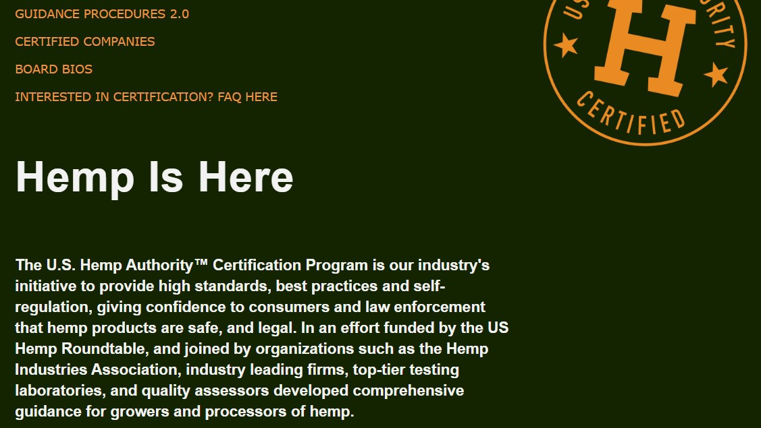
US Hemp Authority

Slide 32
By managing anxiety we are better able to get to sleep.
CBD oil for sleep is so important for some people because of its pain relief
Helps balance our endocannabinoid system, the main job of which is to keep our body in homeostasis
It also prevents our major endocannabinoid, which is called anandamide, from being broken down—and when we have plenty of our own endocannabinoids circulating, not only are we not going to respond as much to a stress, but we’re going to return to baseline faster, so it’s like a recovery system
That’s better than taking sleep medications, which can leave you fatigued and lethargic in the morning.
Why is CBD Good For Sleep?

Slide 33
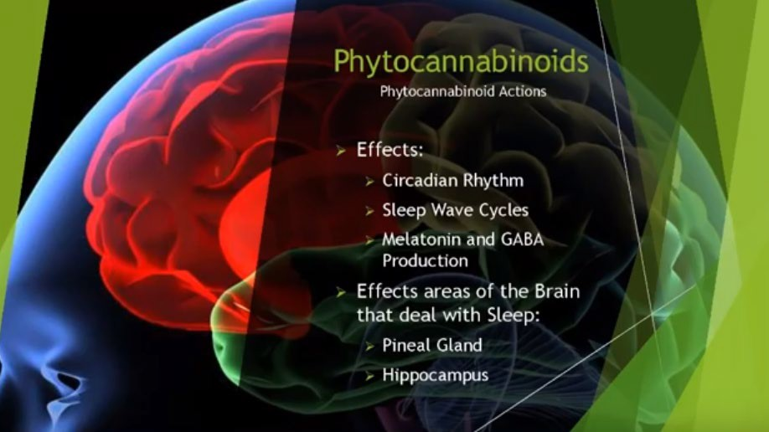

Slide 34
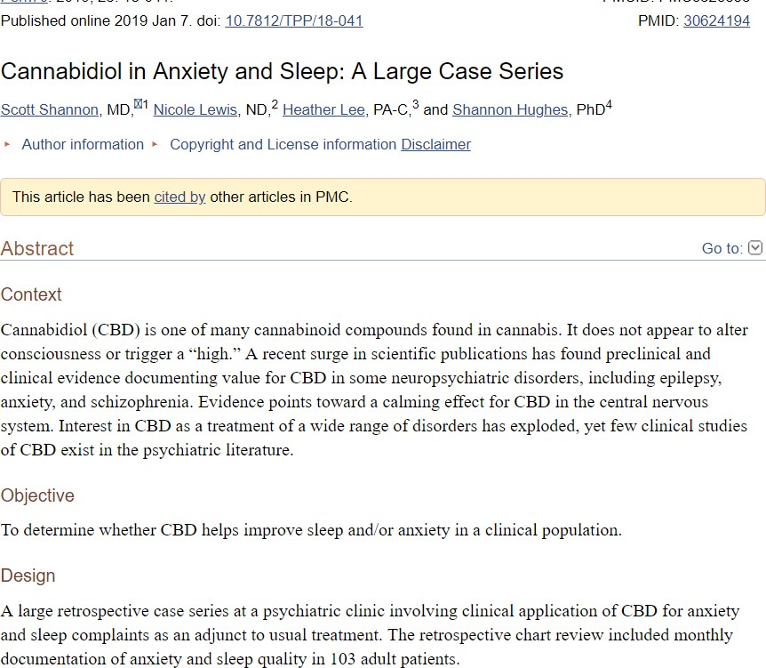
Anxiety = Poor Sleep
72 adults
47 with anxiety as chief complaint 25 with poor sleep as cc
Anxiety scores improved in 79.2% Sleep scores improved in 66.7%

Slide 35
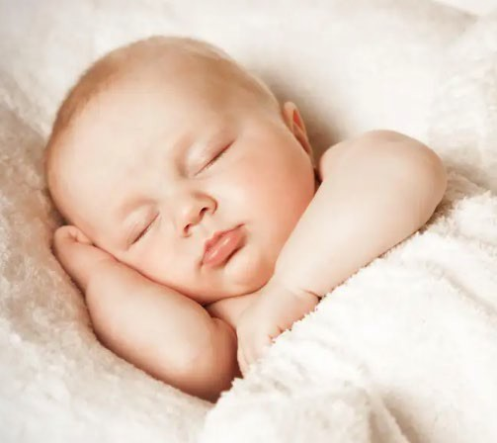
Medical Effects Of CBD On The Body While Sleeping
In smaller doses it has been shown to stimulate alertness, reducing daytime sleepiness which can help keep your circadian rhythm (the natural body clock for sleep) consistent.
CBD has also been shown to reduce REM behavior disorder in people with Parkinson’s.
It also may improve sleep abnormalities for people with post- traumatic stress disorder.

Slide 36

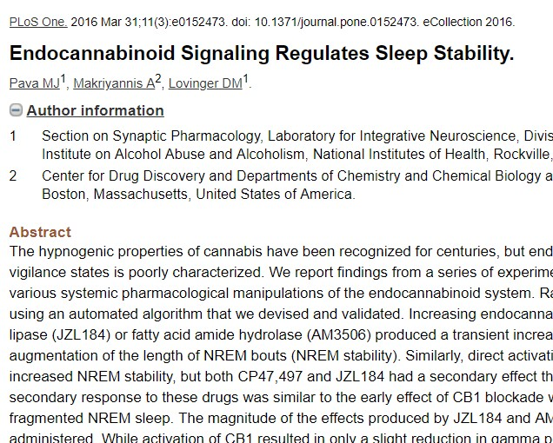
Endocannabinoid Signaling Regulates Sleep Stability
Endocannabinoid signaling through CB1 is necessary for NREM stability.
Through interactions with the cannabinoid receptors, CBD may encourage the endocannabinoid system to function properly so that it’s better able to regulate processes like sleep.

Slide 37
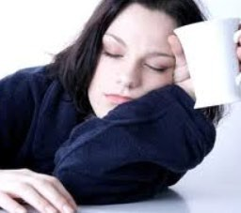
…and alleviates Insomnia
CBD indirectly influences the CB1 receptor and helps the endocannabinoid system work properly so that it can effectively modulate our sleep cycles.
CBD increased dopamine release, causing alertness
Effective in excessive somnolence

Slide 38
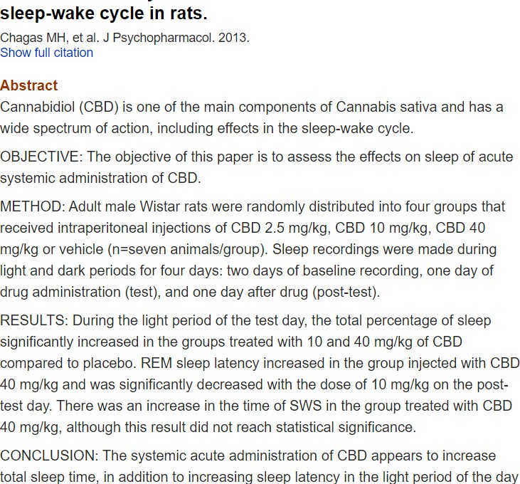
CBD in Rats Increase in total sleep time
Increase in sleep latency during light period of day during administration

Slide 39
As crazy as it sounds, CBD oil for sleep may help with sleep apnea.
Does CBD Oil Help Sleep Apnea?
A few years ago, during clinical trials of Sativex – a synthetic version of CBD and THC – a study was done showing positive outcomes for 40-50% of the subjects who suffered from sleep apnea.
Cannabinoids have effects on the central and peripheral nervous systems which seem to be beneficial to sleep apnea.
While the scientists couldn’t tell for sure why CBD helped sleep apnea, they believe that it increased upper airway muscle tone, which leads to a firmer glottal region and leads to a lessening of the effects of sleep apnea.

Slide 40
Cannabis (THC plus CBD) long term has a negative impact in 2 ways:
Vicious cycle and habituation, leading to more and more cannabis use.
Sleep disturbances are the hallmark of cannabis withdrawal and may lead to relapse. One study showed that 65% said that poor sleep was the primary reason for relapse. Can last up to 45 days post-cessation.
Abrupt cessation leads to decrease
in TST, sleep efficiency and %REM. It increased “wake after sleep onset”, sleep onset latency and PLMs.
Why Not THC?

Slide 41
There are many types of extraction solvents that can be used to separate the essential oils from the stalks and seeds, but typically producers will use some sort of non-toxic CO2 fluid as a solvent.
How is CBD Oil Harvested?
These are regulated by the FDA and are used for commercial extraction in other areas of the food industry.
Those solvents are then forced through the plant material to pull out the CBD and other essential oils and lipids.
The solvent is removed and what you are left with is CBD hemp oil. No THC is gleaned from this process.

Slide 42
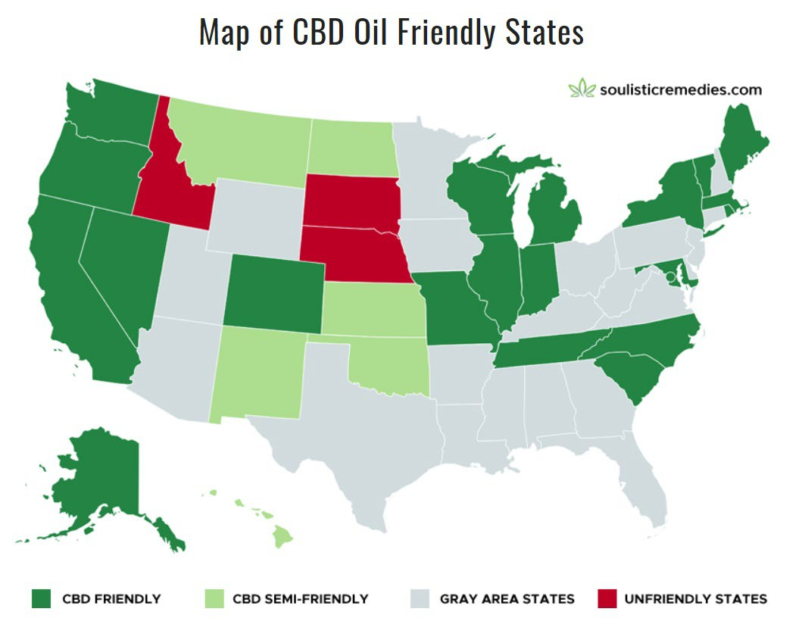

Slide 43
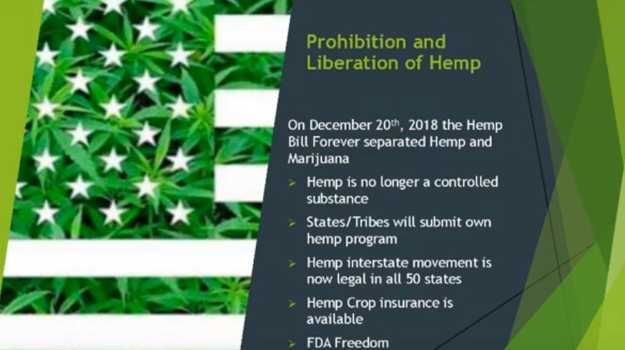

Slide 44
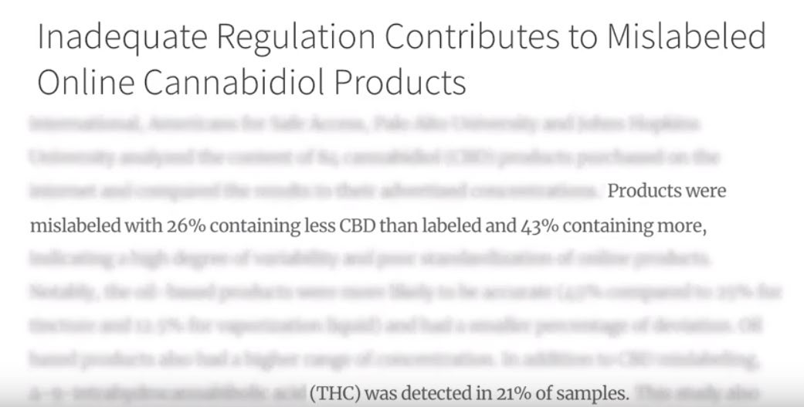
What are you getting when you buy CBD oil?

Slide 45
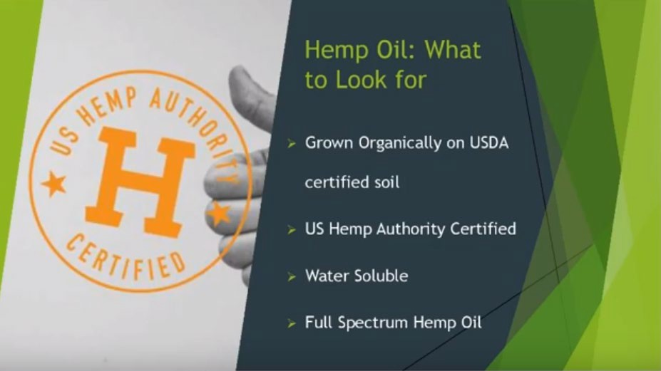

Slide 46
So what about CBG?

Slide 47
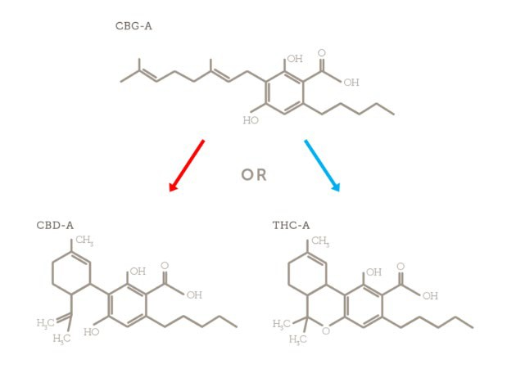
Precursor or “Mother” of CBD-A and THC-A

Slide 48
Direct partial agonist of CB2 receptor
CBG =
Cannabigerol
It binds to the main receptor site on the CB2 receptor whereas CBD binds to an allosteric site.

Slide 49
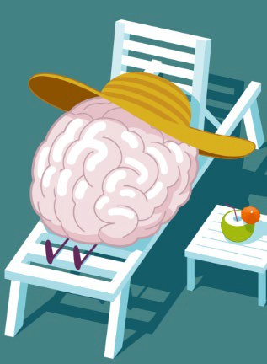
Boosts Anandamide
(the body’s native “Bliss” Molecule)

Slide 50
Other Actions
Antibiotic,
GABA reuptake inhibitor
Primary benefit is gut health
Decreases inflammation | Improves digestion | Decreases bloating

Slide 51

CBG BENEFITS
All about the entourage effect and the ECS
Great support for immune function
Particularly helps over-active immune function
Reduces oxidative stress (antioxidant)
Is antifungal and slows bacterial growth
Is neuroprotective
Prevents inflammatory damage to nerve cells
Gugliandolo. Int Journal of Molecular Science 2018 July; 19 (7)

Slide 52

CBG BENEFITS
Helps relax muscles
Supports occasional pain relief more than THC
Helps reduce muscle contractions in the bladder
Helps relaxation of bladder muscles
Helps support healthy bladder function
Supports gut health
“CBG also reduced acetylcholine-induced
contractions in the human bladder.”
(Pagano E. Nat Prod Commun. 2015 Jun;10(6):1009-12.)

Slide 53
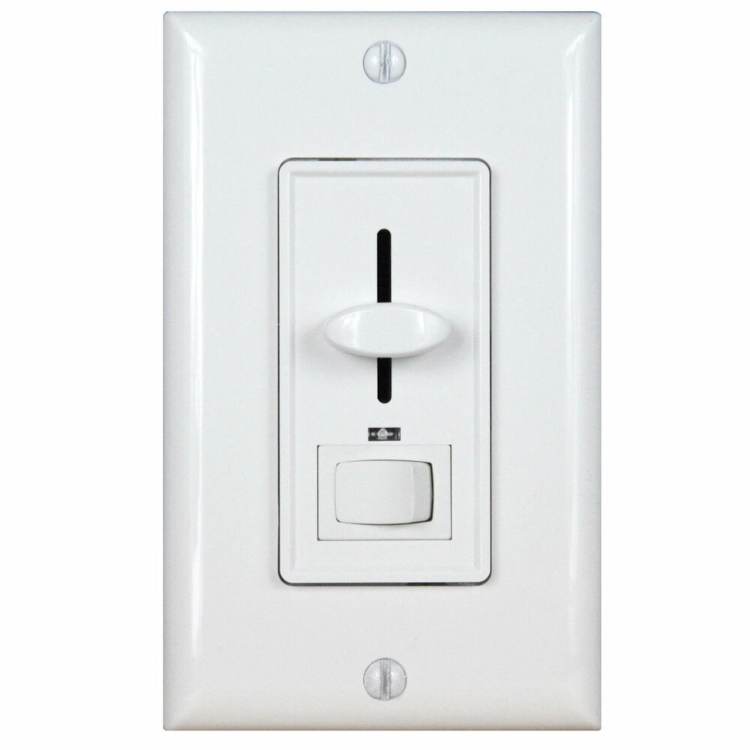

CBD or CBG impact on CB2 Receptors
CBD and CBG both work on endocannabinoid receptors (CB1 and CB2)
CB2 receptors are present in connective tissue and all major immune tissues in the body,
including every single white blood cell
CBG is the main activator of CB2 receptors (i.e.
CBD
actually turns it on)
CBD is a partial activator of CB2 receptors (i.e. can turn it up)
CBG
Whereas CBD binds to an ALLOSTERIC site
Layman’s terms: CBD can turn it up, but it first has to be turned on by CBG
Meaning: CBD will multiply the benefits of CBG!

Slide 54
Like Sophie’s Choice, you have to either extract CBG in larger amounts before it converts to other cannabinoids like CBD or you wait until it’s time to harvest the hemp plant and only get minute amounts of CBG.
Thousands of pounds of biomass to produce a small isolate of CBG
Most Expensive to Produce
Also requires highly specialized and pricey equipment.
About 5 companies in the U.S. currently make it.

Slide 55
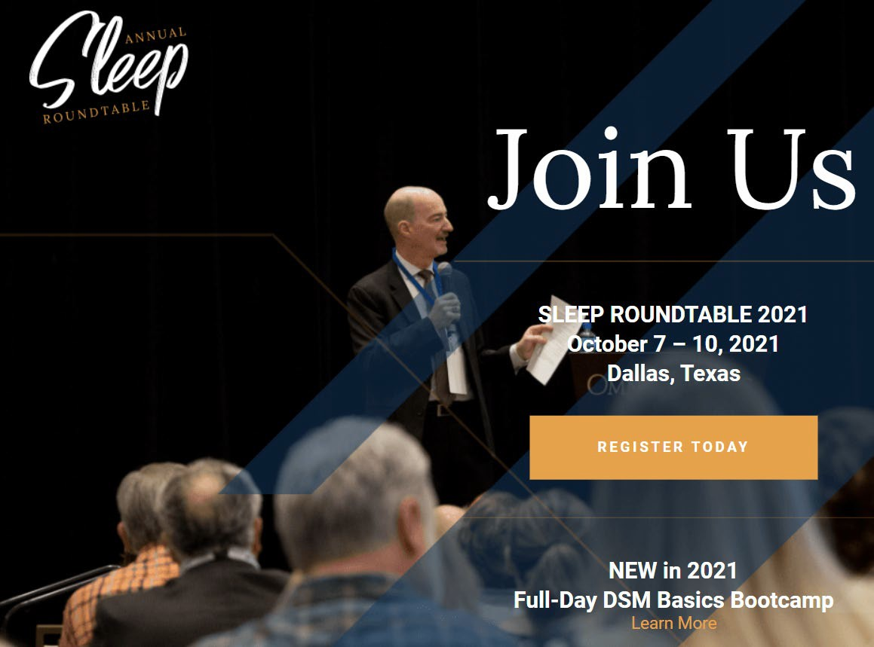
10th Annual Sleep Roundtable
www.SleepRoundtable.com

Slide 56

Questions?
Info@SleepDallas.com

