Slide 1
Cardiac Function and Sleep
An Interactive Discussion
July 24, 2021

Slide 2


Speakers
Atul Malhotra, MD
Research Chief of Pulmonary, Critical
Care and Sleep Medicine
UC San Diego Health
Jennifer Cook, MD
Professor of Medicine, Heart Failure
University of Cincinnati
Global Medical Director
Itamar Medical, Inc

Slide 3
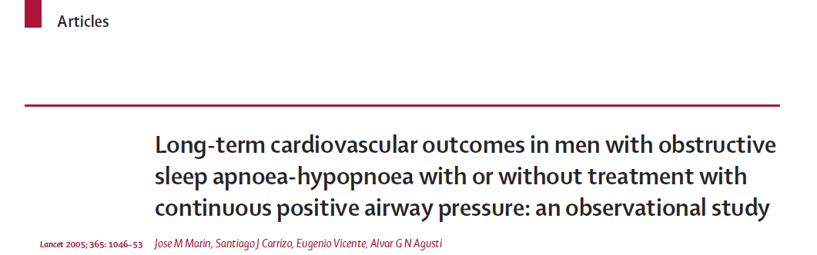
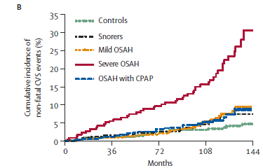
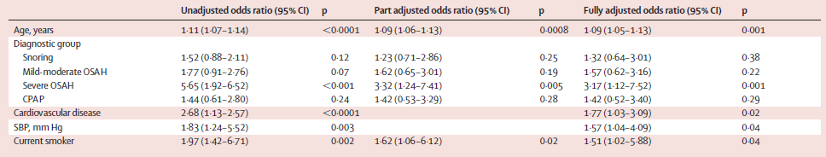
Cumulative Incidence of Non-Fatal Cardiovascular Events
Marin JM et al Lancet 365(9464):1046-53
Odds Ratio of Non-Fatal Cardiovascular Events

Slide 4
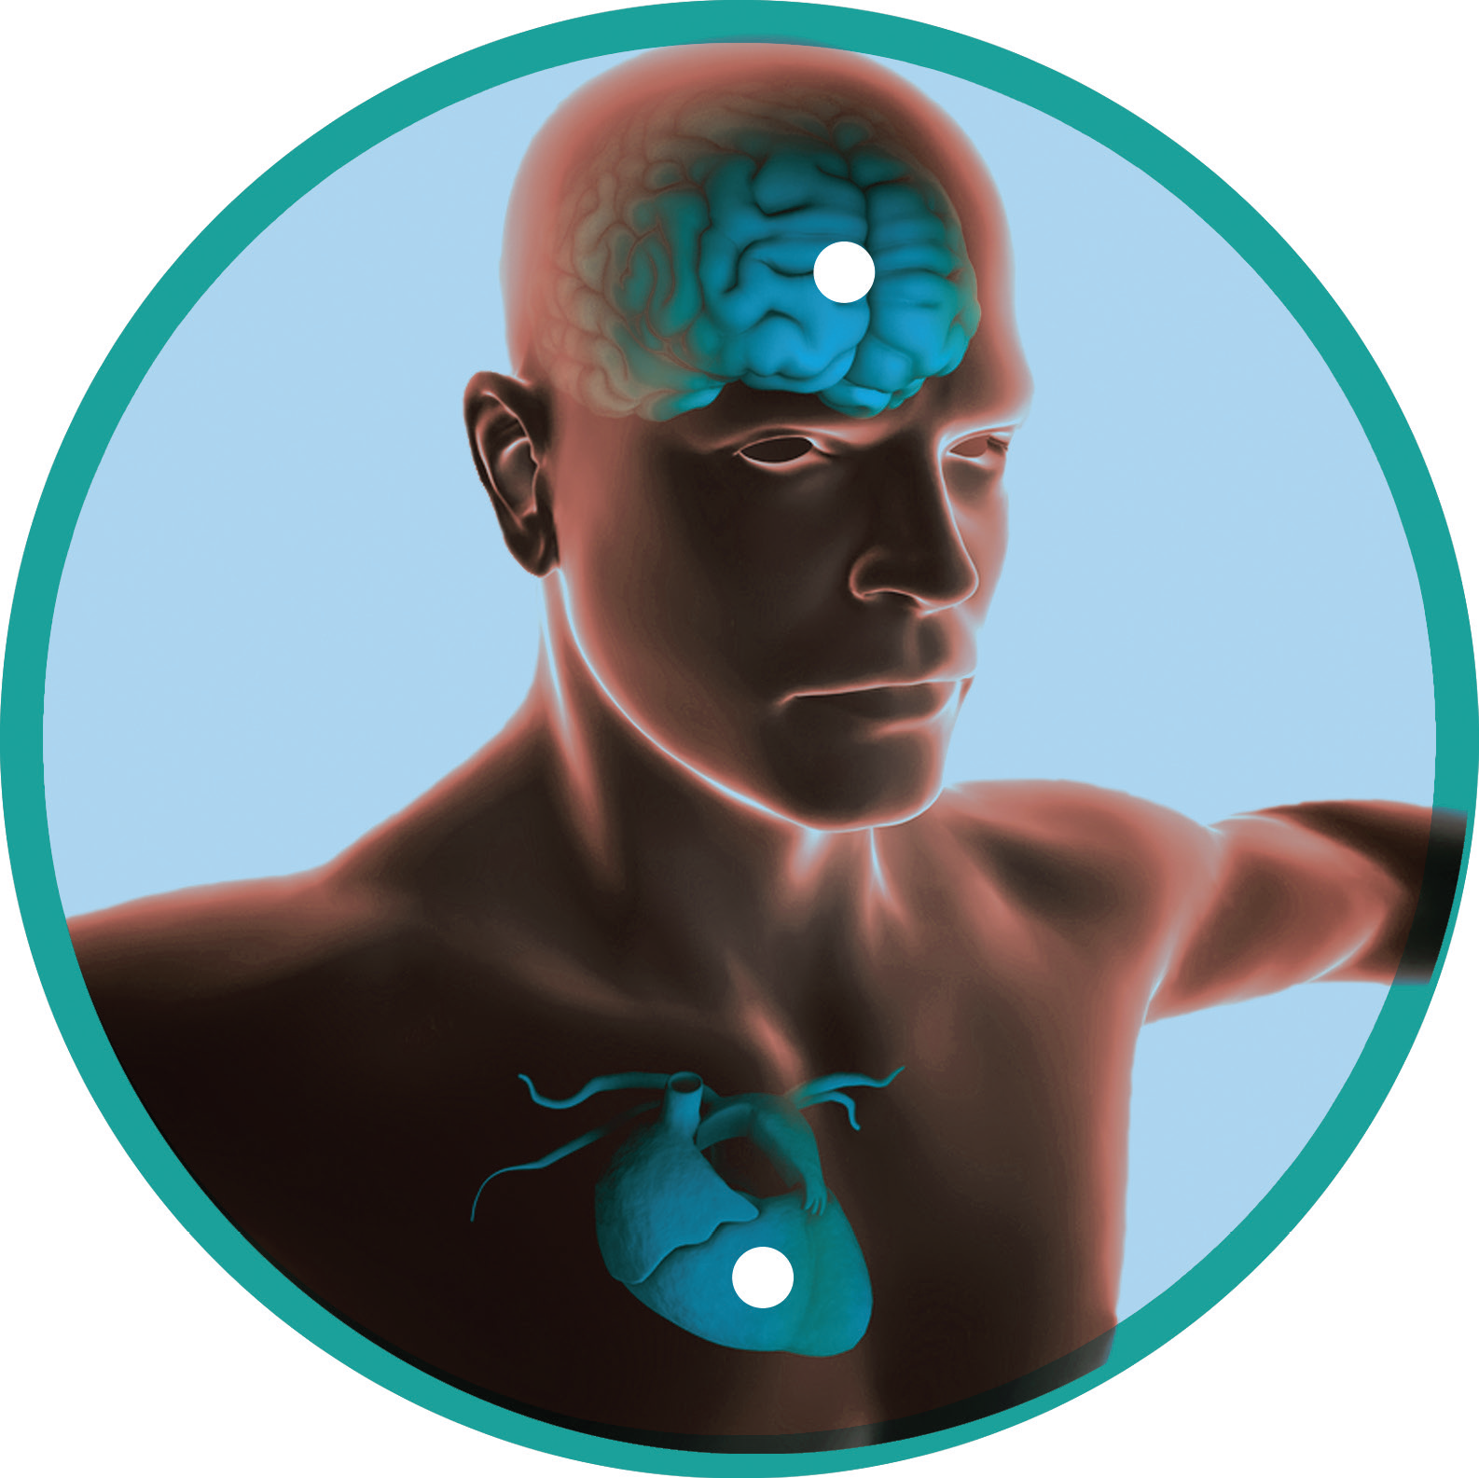
Increased Risks of Leaving Sleep Apnea Untreated
2x
Increased risk of stroke¹
2x
Risk of death from sudden cardiac arrest²
5x
Risk of death from cardiovascular disease³
42%
Increased risk of recurrence of atrial fibrillation following ablation⁴
Sources:
1) Sleep Apnea and Incident Stroke, Redline et al, The Sleep Heart Health Study. American Journal of Respiratory and Critical Care Medicine Vol 182 2010;
2) Obstructive Sleep Apnea and the Risk of Sudden Cardiac Death Gami et al, J Am Coll Cardiol 2013:
3) Young et al, J Sleep 2008;
4) Effect of Obstructive Sleep Apnea Treatment on Atrial Fibrillation Recurrence Shukla, Chinitz JACC Clinical Electrophysiology Vol 1 ,No 1-2 , 2015

Slide 5
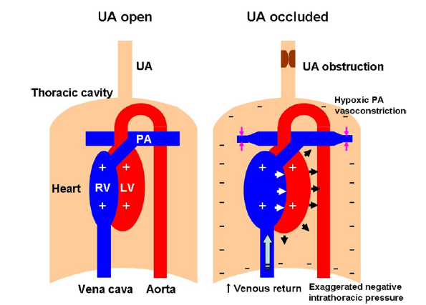
Effects of OSA on the RV and LV
Kasai and Bradley JACC 2011
Increased venous return to RV
Increased PA vasoconstriction and PH
RV distension and leftward displacement of septum during diastole
Impaired LV filling
Decreased LV preload and stroke volume
Increased LV afterload
Decreased Cardiac Output in HF patients
Notes:
During obstructive sleep apnea (OSA), negative intrathoracic pressure generated against the occluded upper airway (UA) increases left ventricular (LV) transmural pressure
(intracardiac minus intrathoracic pressure) and LV afterload. It also increases venous return, augmenting right ventricular (RV) pre-load, whereas OSA-induced hypoxia causes PA vasoconstriction and pulmonary hypertension. These cause RV distension and leftward displacement of the interventricular septum during diastole, which impairs LV filling and diminishes LV pre-load and stroke volume. This combination of increased LV afterload and diminished
preload reduces stroke volume and cardiac output more in HF patients than in healthy subjects (27,28 ). Whereas stroke volume recovers abruptly to baseline in healthy
subjects at apnea termination, recovery is delayed in patients with HF (24 ).
Increased LV transmural pressure also increases myocardial oxygen demand while simultaneously reducing coronary blood flow during which apnea-related hypoxia reduces oxygen delivery (2,24,29 ). This can precipitate myocardial ischemia and impair cardiac contractility and diastolic relaxation
(30,31 ). Over time, such stresses may contribute to development or progression of cardiac remodeling, hypertrophy, and failure.

Slide 6
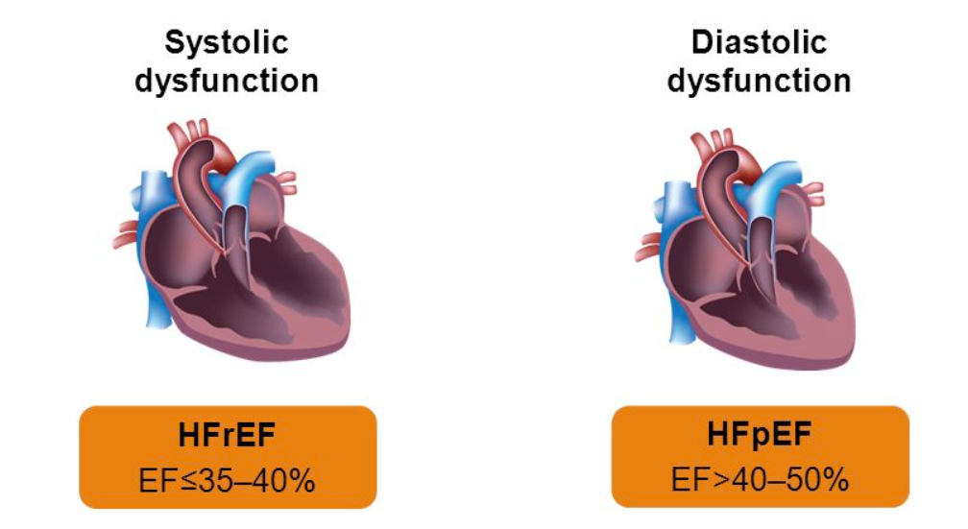
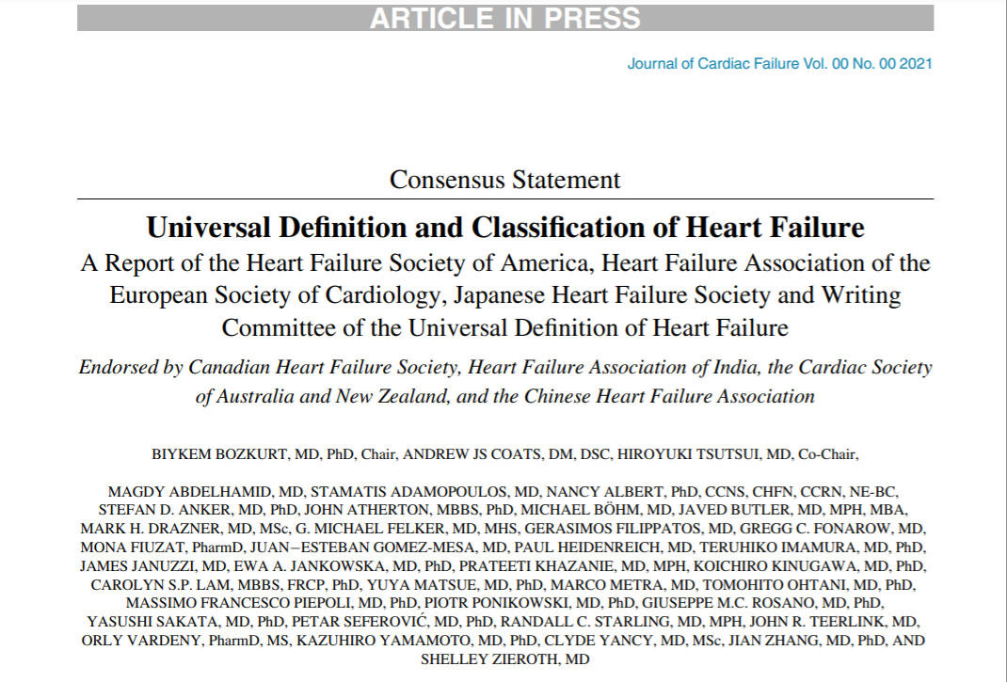
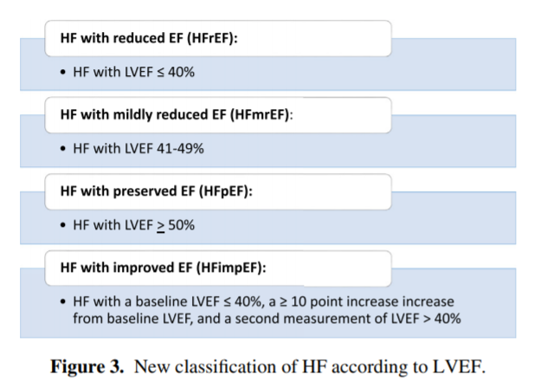
Photo credit: https://twitter.com/USMLEStepStudy/status/1233141914289025048/photo/1
Notes:
Mel

Slide 7
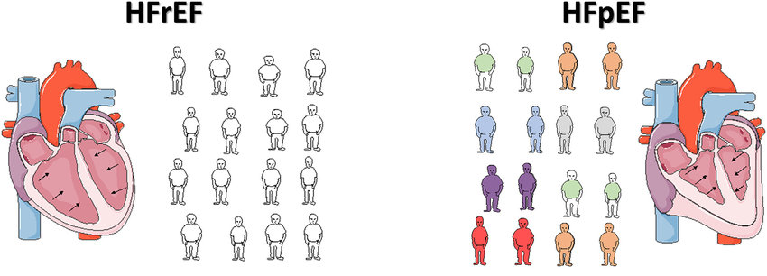
Patient phenotype differs
Photo credit: https://www.hfpolicynetwork.org/wp-content/uploads/HFPN-Spotlight-on-HFpEF.pdf
HF reduced EF
EF <40%
Ischemic
Non-Ischemic
Valvular
HF preserved EF
EF >50%
Hypertension
Diabetes
Obesity

Slide 8
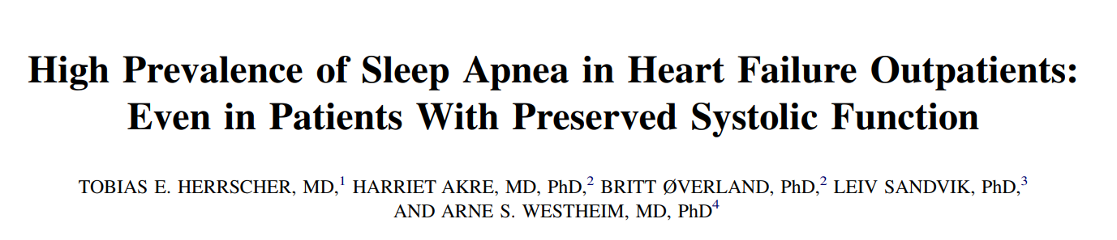
Herrscher et al J Card Fail 2011; 17:420-425
Normal
19%
Results
OSA highly prevalent in HF (n=115)
Both HFrEF (81%) and HFpEF (80%)
Significant burden of central apnea
OSA
49%
CSA
32%
Prevalence in HFrEF, EF ≤45%
Conclusions
Equally prevalent in HFrEF and HFpEF
Systemic screening necessary
Sleep testing must differentiate CSA
Normal
20%
CSA
18%
OSA
62%
Prevalence in HFpEF
Notes:
When talking to cardiologists you will not have to explain what HFrEF and HFpEF are….. But you will need to define AHI and describe when you treat OSA

Slide 9
One Size Does Not Fit All
Its important to differentiate the type of heart failure and the associated sleep apnea subtype.
The therapies are different
The clinical data are different
*Being able to differentiate OSA from CSA in these patients is critical.
OSA
CSA
CPAP
ASV
CPAP
Phrenic nerve stimulation
HFpEF
HFrEF

Slide 10
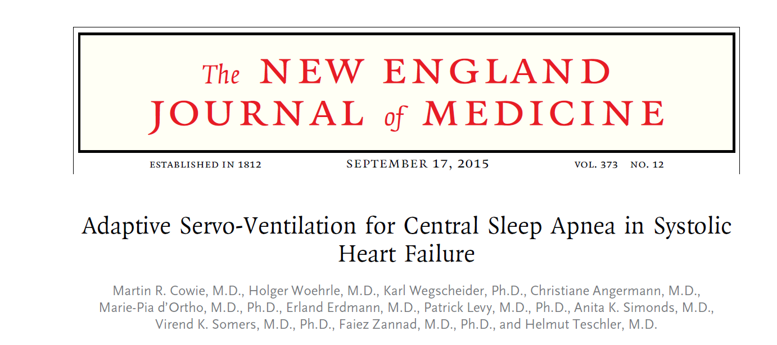
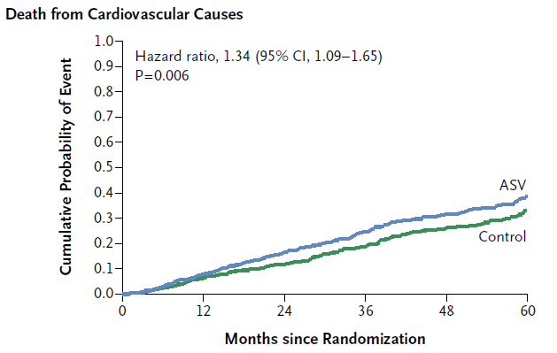
Cowie et al NEJM 2015; 373
Results
Treatment of CSA in HF with ASV
Reduced AHI, no survival benefit
Increased CV mortality (29.9% v. 24%)
Conclusions
Avoid ASV in CSA
Hypotheses
Decreased CO (PAP in ASV mode)
Proprietary algorithm- hyperventilation

Slide 11
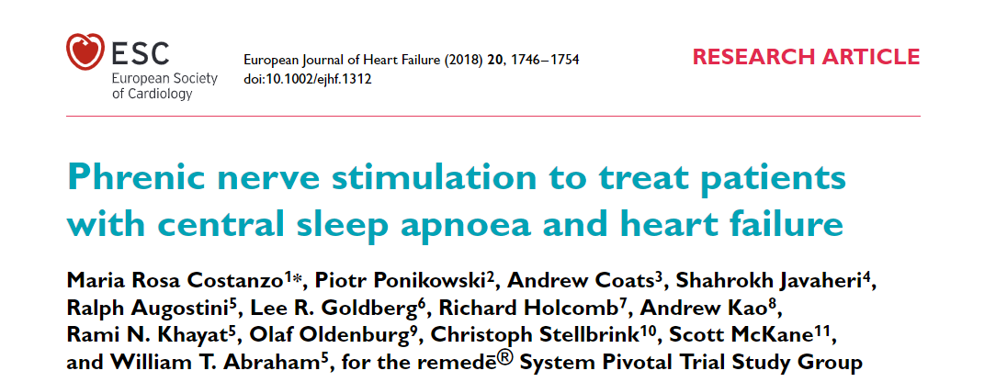
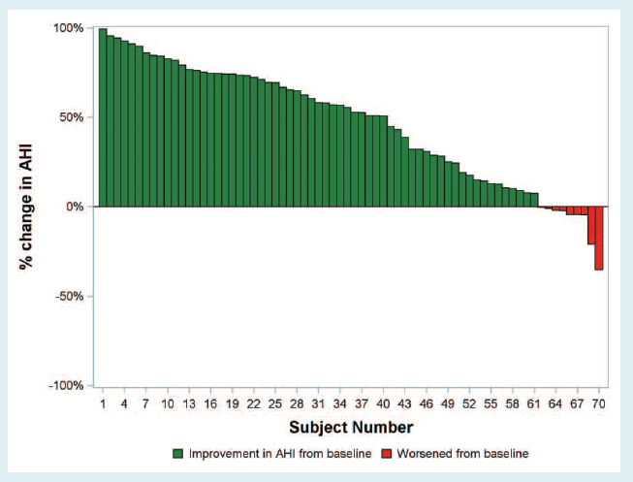
Costanzo MR et al Eur J HF 2018; 20:1746-1754
Results
HF patients (n=96)
Improvements in ESS, MLHFS
Reduction in LVEF
Conclusions
Phrenic nerve stimulation reduces CSA severity
CSA treatment associated with benefits in HF quality of life

Slide 12
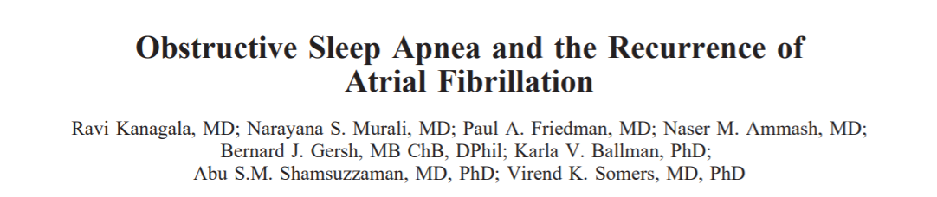
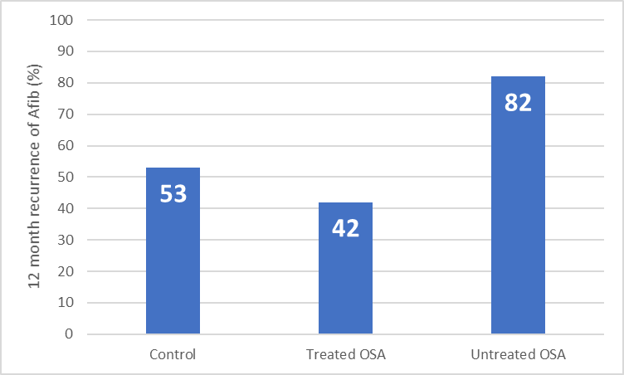
Kanagala R Circ 2003; 107: 2589
p=0.009
p=0.013
Results
OSA patients (n=43), untreated (n=25)
AF or AFl, referred for DC cardioversion
Compared to no OSA (n=79)
p=0.46
Conclusions
12-month AF recurrence double if OSA untreated

Slide 13
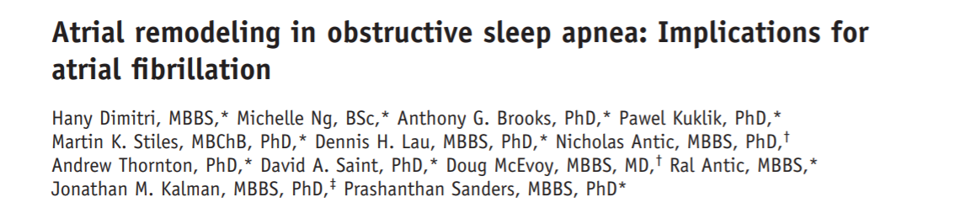
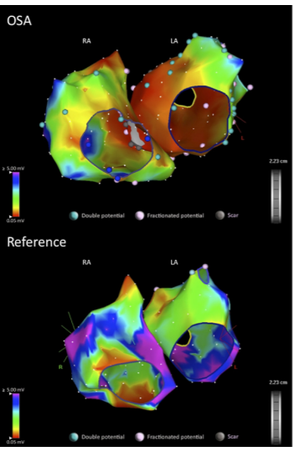
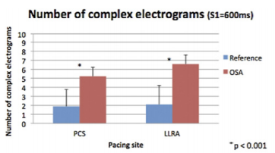
Dimimtri H et al Heart Rhythm 2012; 9(3):321-327
Results
Prolonged conduction times
Longer P-wave duration
Longer corrected sinus node recovery time
Lower atrial voltage
Slower atrial conduction velocity
More widespread complex electrograms
Conclusions
OSA is associated with atrial remodeling

Slide 14
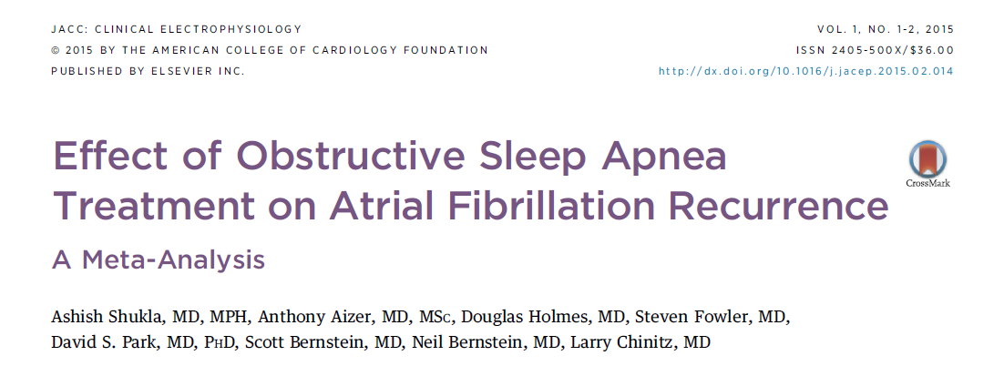
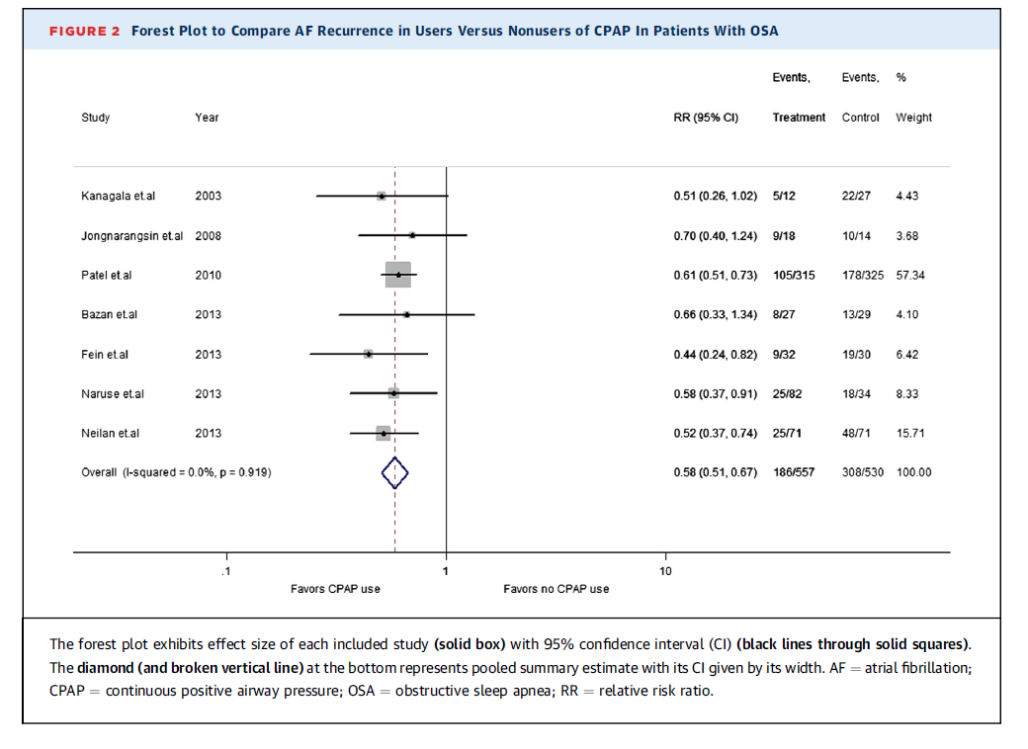
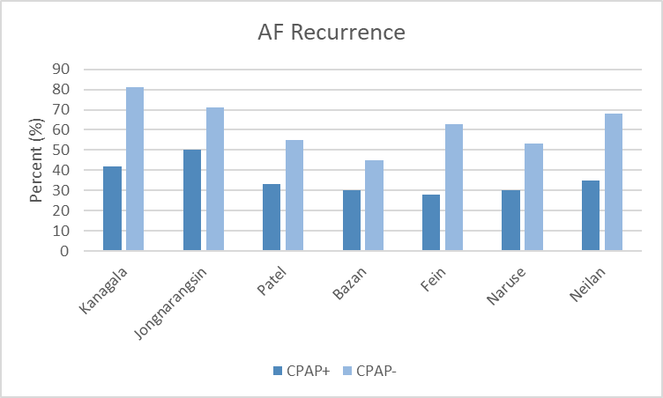
Shukla A et al JACC: Electrophysiology 2015;1:41-51
Results
Seven prospective cohort studies
Patients with AF (n=1,087)
Reduction of AF recurrence post PVI
RR 0.58 (among studies range 0.44-0.70)
Conclusions
CPAP is associated with reduction in recurrence of AF post ablation

Slide 15
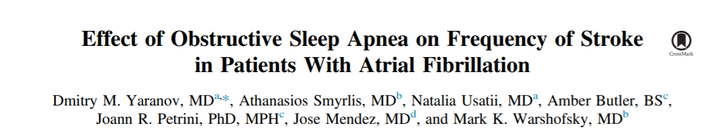
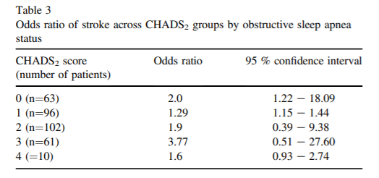
Yaranov DM et al Am J Card 2015:461-465
Results
OSA is RF for CVA
Not included in risk scores
New diagnosis of OSA (n=5,138)
AF in 402 (7.7%)
Ischemic CVA 22.9%
OSA 25.4% vs non-OSA 8.2%
Adjusted OR 3.65, p 0.006
Conclusions
OSA in patients with AF is an independent predictor of stroke

Slide 17
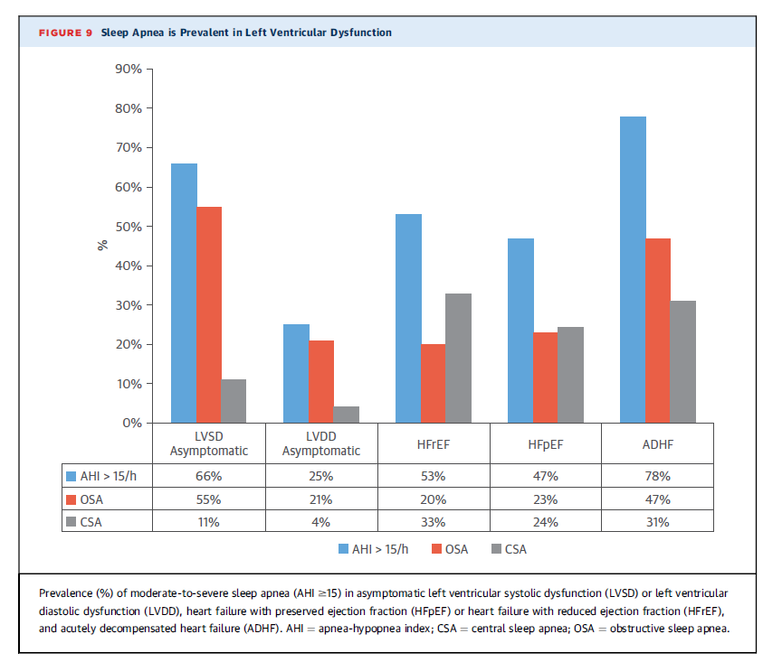
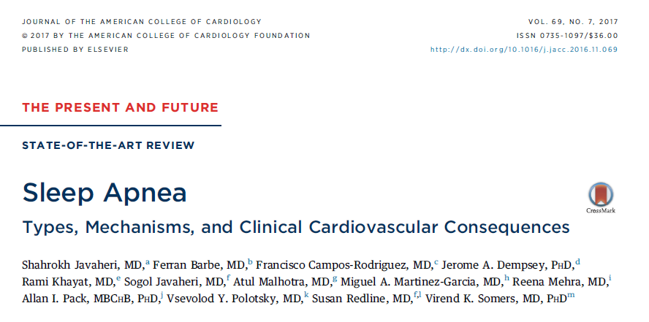
Prevalence of Sleep Apnea in Heart Failure
Source:
1 – Javaheri et al. Sleep Apnea – Types, Mechanisms, and Clinical Cardiovascular Consequences. JACC 2017. Vol 69 (7). 841-58

Slide 19
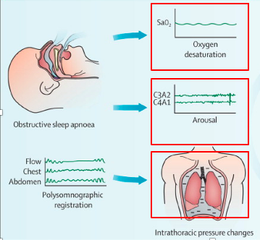
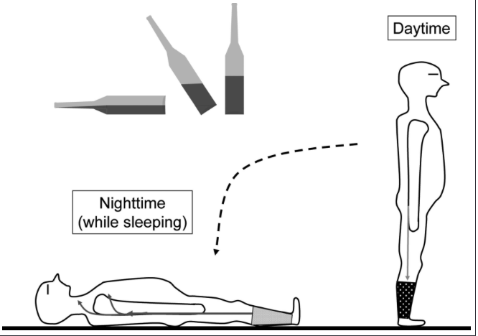
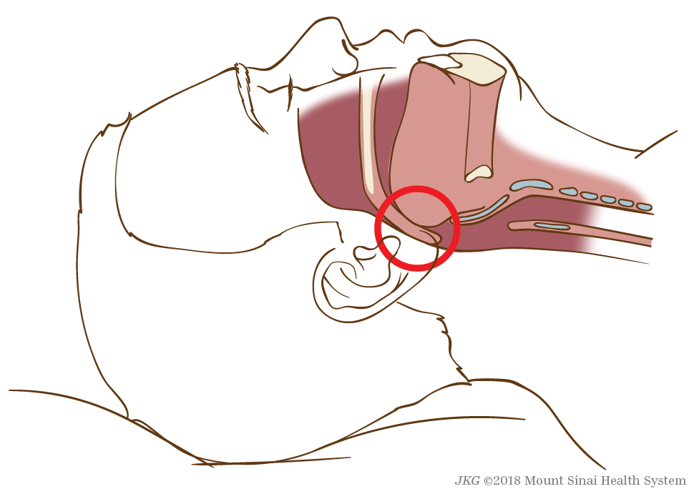
Pathology and Pathophysiology of OSA
Kasai et al. Circ 2012
Notes:
As we all know there are two main types of sleep apnea, obstructive and central.
Apneas or hypopneas are classified as obstructive or central
they result from an absence or reduction of brainstem neural output to the upper airway muscles (e.g., genioglossus) and/or the inspiratory pump muscles (diaphragm and intercostal muscles).
The pattern of neural output determines the phenotype: OSA occurs when complete upper airway occlusion occurs (absent airflow, tongue falling backward) in the face of continued activity of inspiratory thoracic pump muscles. In contrast, CSA occurs when there is a transient reduction by the pontomedullary pacemaker in the generation of breathing rhythm. The 2 most common causes in adults are HF and opioid use.

Slide 20
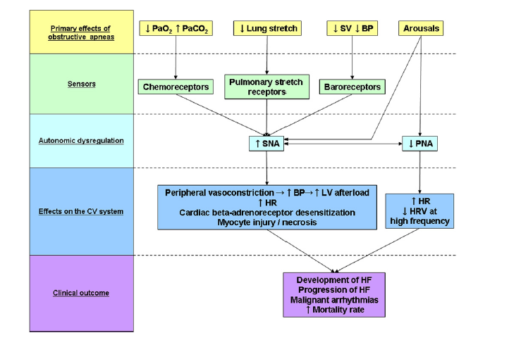
Autonomic Effects of OSA
Kasai and Bradley JACC 2011
Elevated SNA is associated with increased mortality in HF patients
Notes:
This diagram illustrates a number of mechanisms by which obstructive sleep apnea (OSA) augments sympathetic and diminishes parasympathetic activity. BP blood pressure.
Intermittent hypoxia and CO2 retention stimulate central and peripheral chemoreceptors that augment SNA (32) (Fig. 2). Apnea also enhances SNA by eliminating reflex inhibition of SNA arising from pulmonary stretch receptors (33). Reductions in stroke volume and BP during obstructive apneas unload carotid sinus baroreceptors and reflexively augment SNA. This is exaggerated in patients with HF

Slide 21
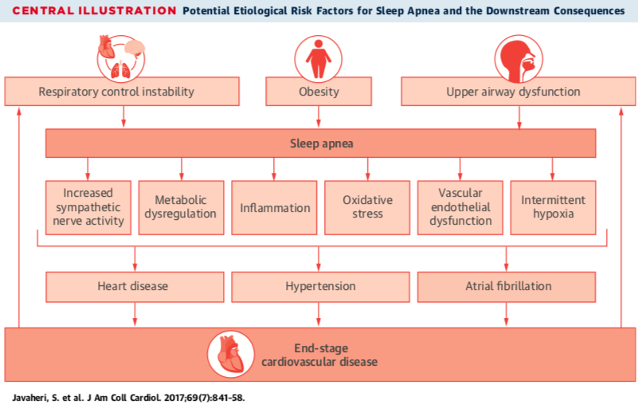
Summary

Slide 22
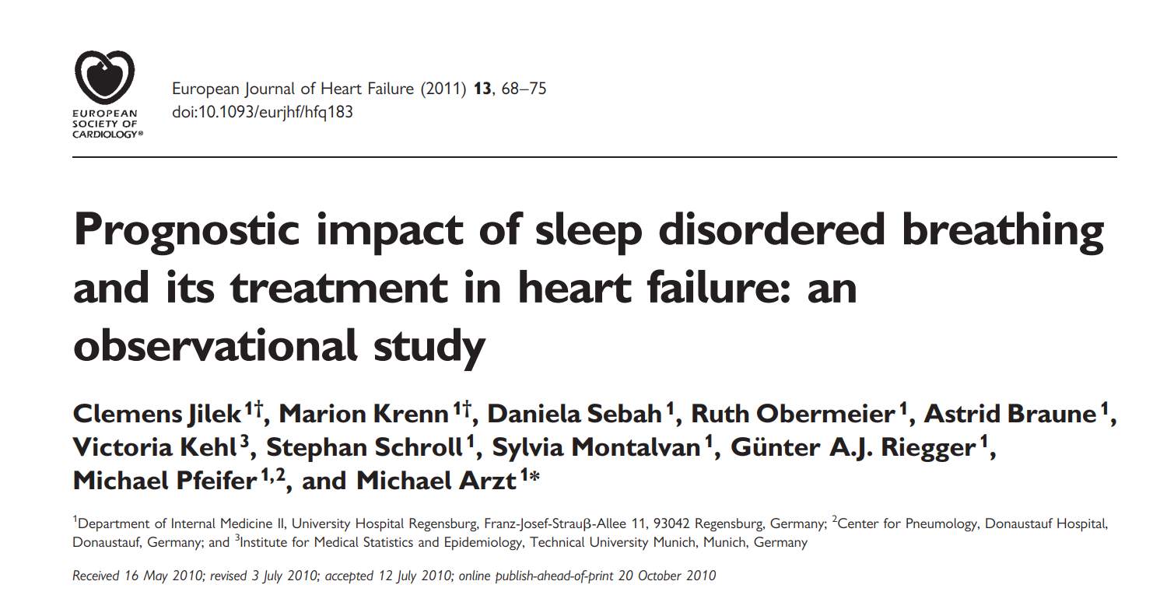
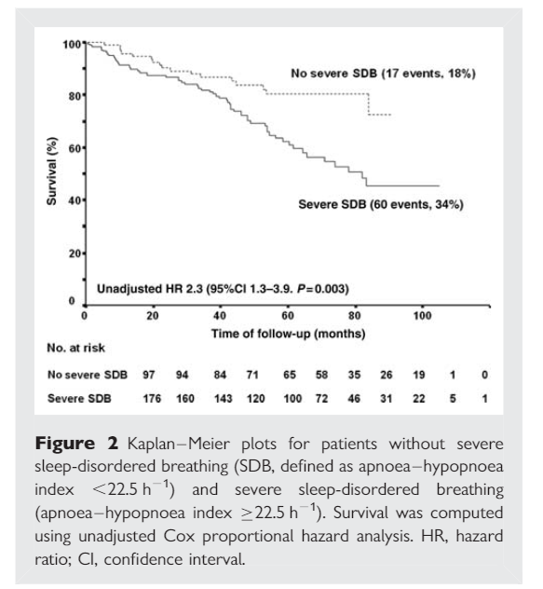
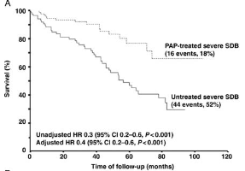
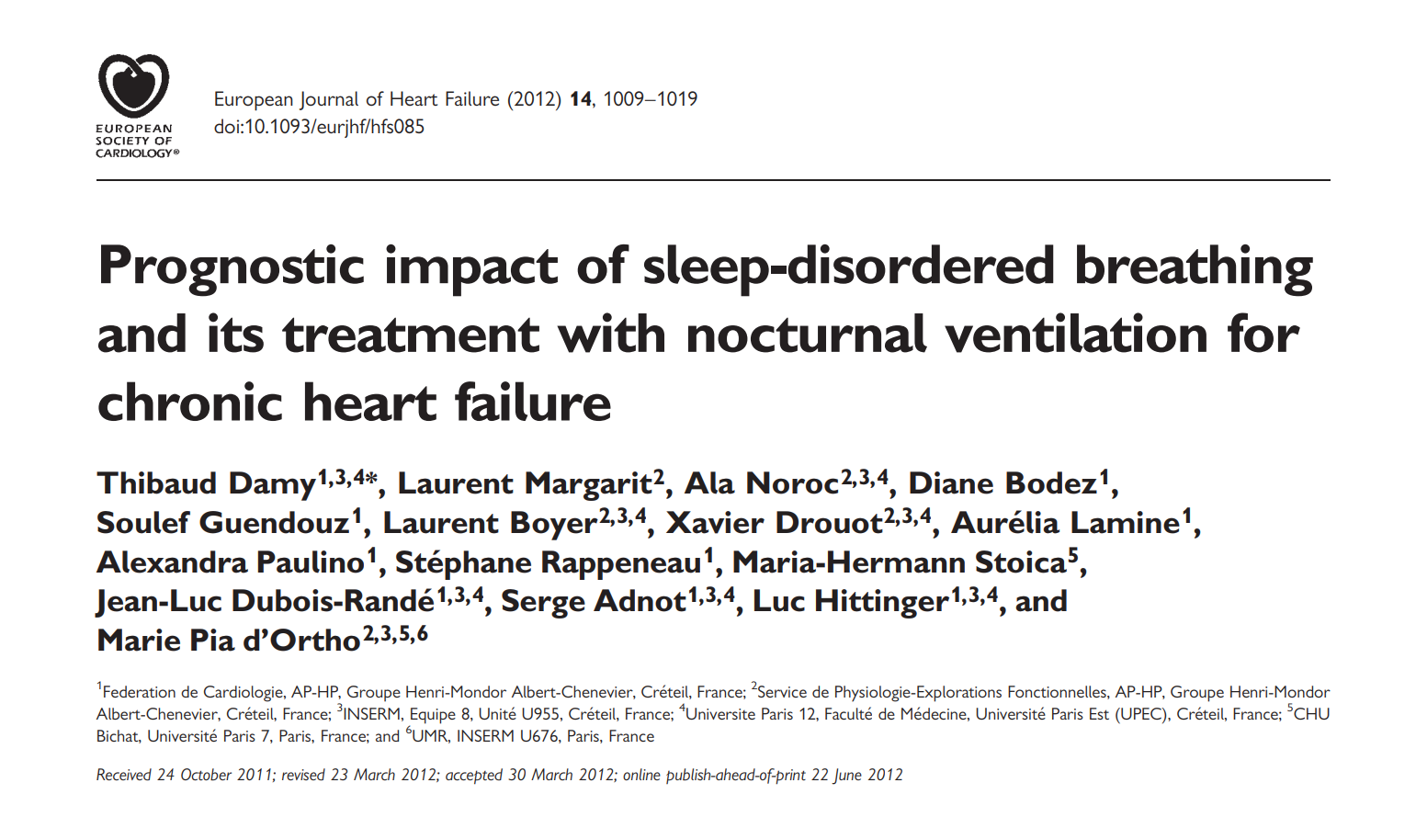
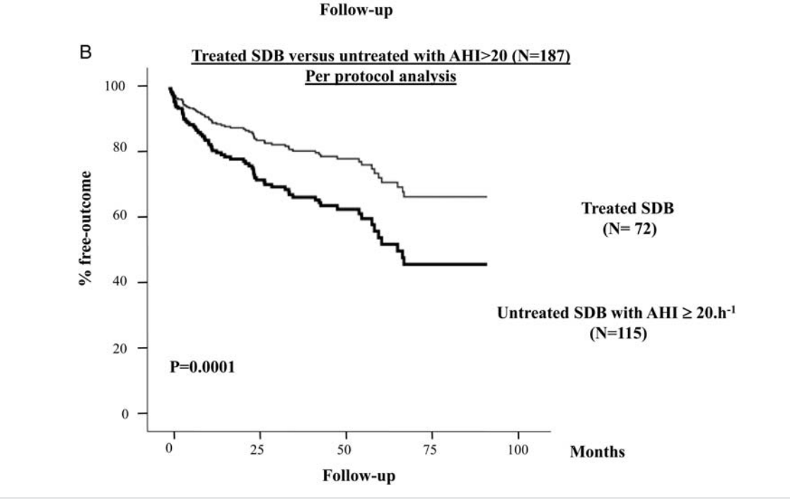
Results
296 patients
Severe SDB, AHI≥22.5
Mortality PAP (18%) no-PAP (52%), p=0.001
Jilek et al Eur J of HF 2011; 13; 68-75
Conclusions
Severe SDB constitutes increased mortality
PAP therapy is associated with decreased mortality

Slide 23
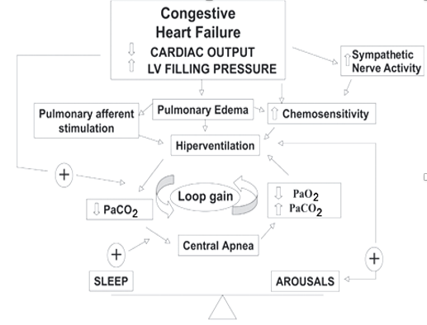
Pathology and Pathophysiology of CSA/CSR
Instability in the respiratory control system
Major factors:
  High ventilatory drive
  Delay in chemoreceptor response to changes in PCO2 and PO2 (due to prolonged circulation time)
Usually due to a low PCO2 during wake and sleep
Increased responsiveness of peripheral and central chemoreceptors leads to hyperventilation
  Increased sympathetic tone
  Stimulation of irritant receptors in the lung from pulmonary congestion
PaCO2 in CSA/CSR patients is closer to their apneic threshold therefore even slight increases in ventilation drives PCO2 levels below apneic threshold

Slide 24
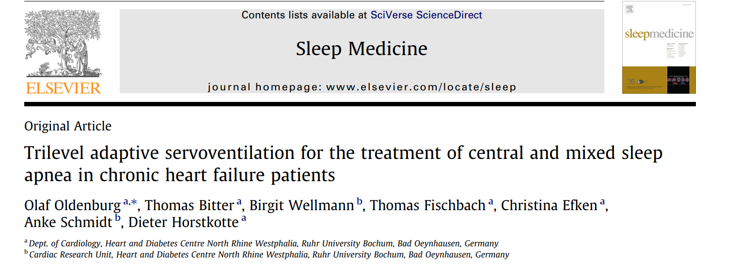
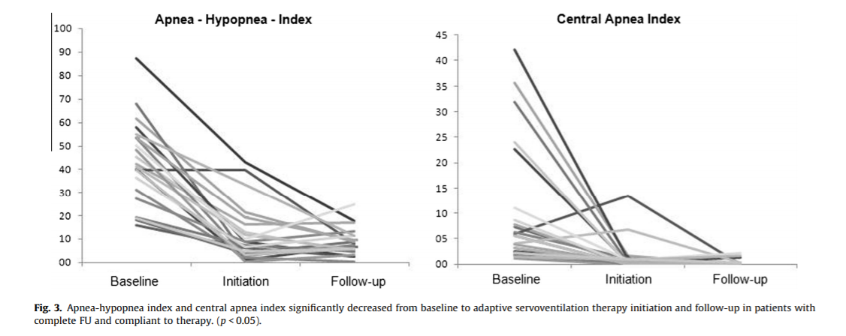
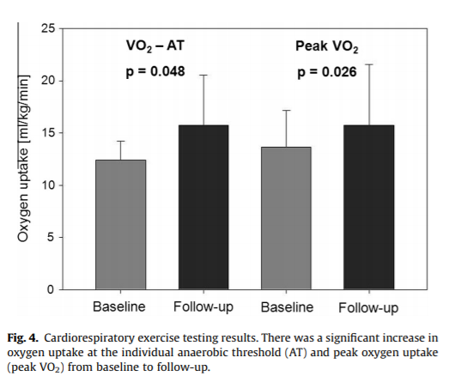
Results
45 patients
AHI ≥ 15
Central and mixed apnea
Oldenburg et al Sleep Medicine 2013; 14:422-427
Conclusions
Sustained reduction in AHI
Improvement in NHYA class
Improvement in VO2 max

Slide 25
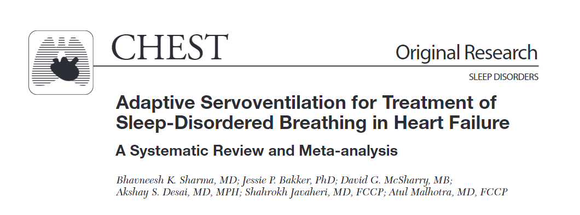
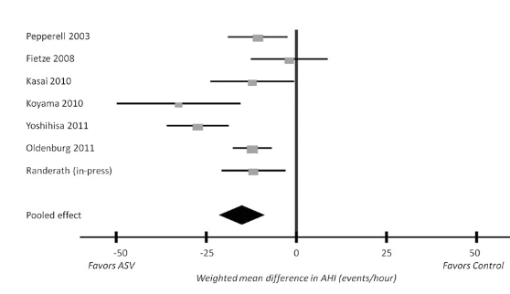
57 articles
538 patients (7 studies)
ASV v. control
Weighted mean difference
-14.64 events/h (p=0.0001)
Sharma et al CHEST 2012; 142:1211-1221

Slide 26
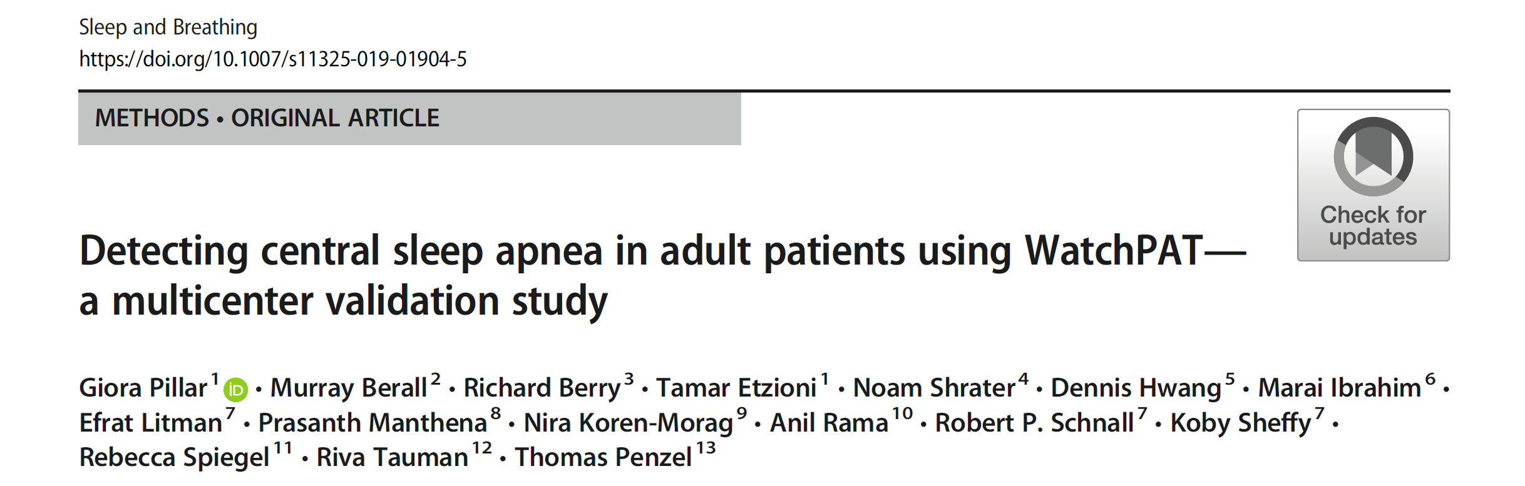
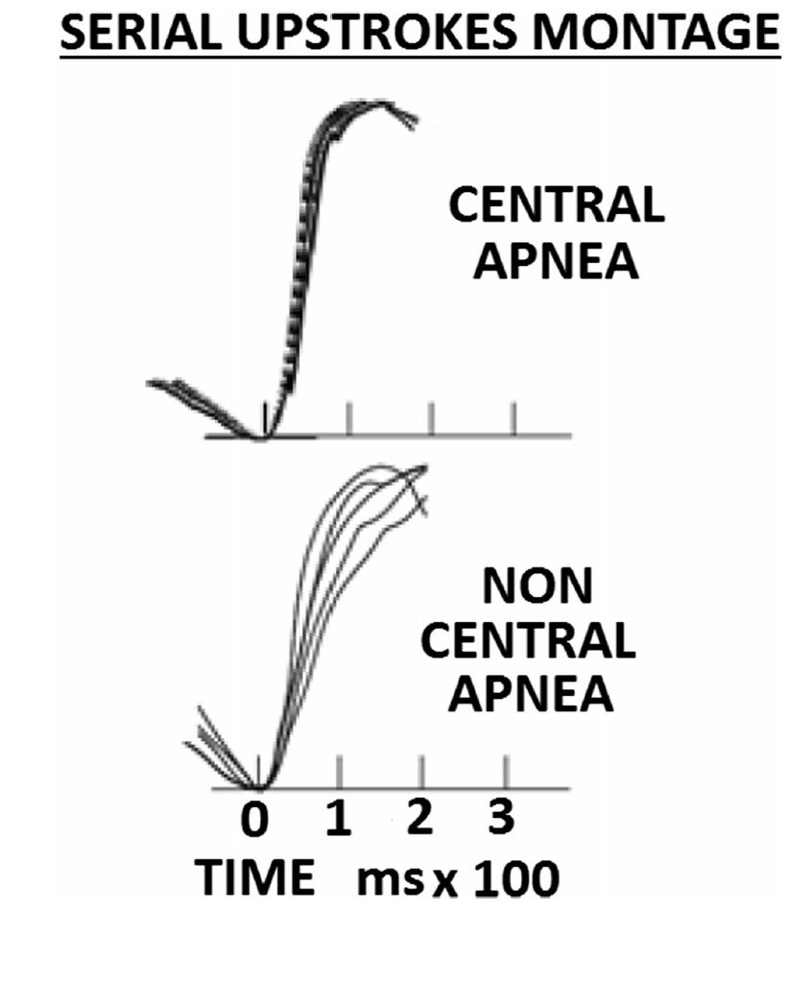
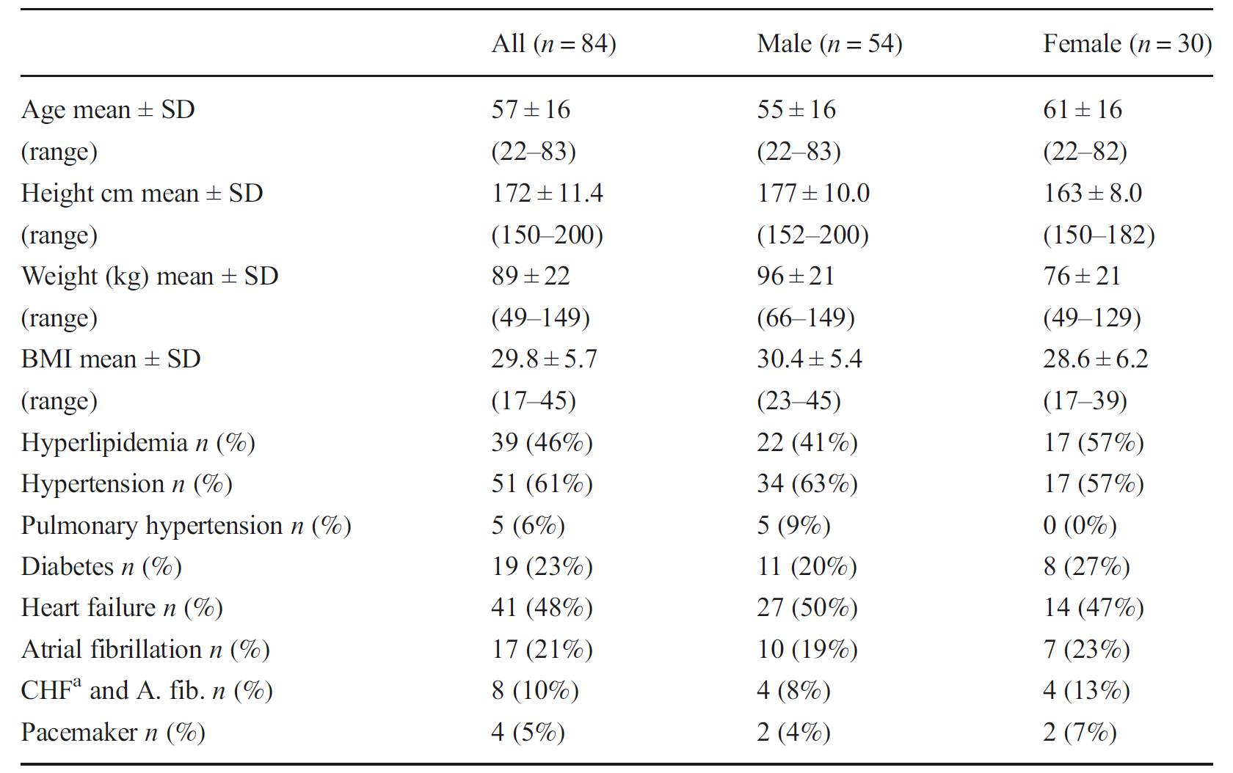
Pillar et al Sleep and Breathing 2019; ePub
Results
WatchPAT vs. standard PSG
84 patients
CHF n = 33, Afib n=9, both n=8
Conclusions
WatchPAT differentiates OSA from CSA in HF
Pillar G et al Sleep and Breath 2019 Aug 11 ePub

Slide 27
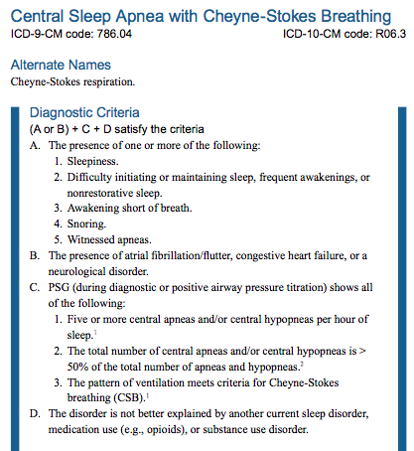

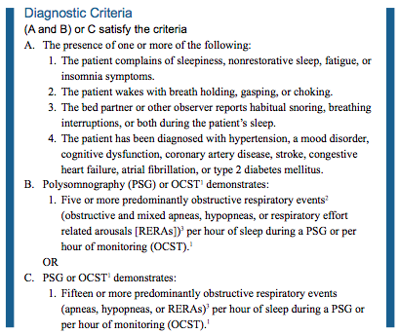
Diagnostic Criteria:
AASM International Classification of Sleep Disorders V3

