Slide 1
MANAGING THE
SLEEP BREATHING DISORDER
PATIENT
(SBD)
BEFORE, DURING, AND Follow up
DR. SUZANNE MERICLE
Notes:
Before screening, During treatment and follow up.

Slide 2

Managing the SDB Patient
Dentists working beside Physicians… Together working for the Patient…
Notes:
Working together is what is best for patient. This also creates mutual relationships between the physician and the dentist

Slide 3
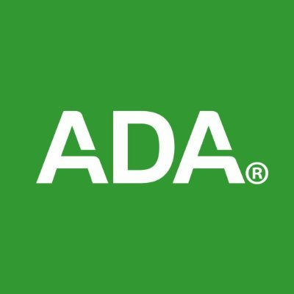
ADA’s POLICY
Dentists are encouraged to screen patients for SRBD as part of a comprehensive medical and dental history to recognize symptoms such as daytime sleepiness, choking, snoring or witnessed apneas and an evaluation for risk factors such as obesity, retrognathia, or hypertension. If risk for SRBD is determined, these patients should be referred, as needed, to the appropriate physicians for proper diagnosis.
Adopted by ADA’s 2017 House of Delegates
Notes:
ADA adopted a policy in 2017 encouraging dentists . well as fabrication and maintenance of properly fitted oral appliances treatment. It emphasizes that dentists are the only health care provider with the knowledge and expertise to provide oral appliance therapy

Slide 4
Dental Sleep medicine
… is an area of dental practice that focuses on the use of oral appliance therapy to treat sleep-disordered breathing, including Snoring, and Obstructive Sleep Apnea (OSA). Dentists work together with physicians to identify the best treatment for each patient. The process begins with screening each patient…

Slide 5
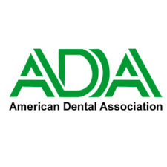
DENTIST’S ROLE IN MANAGING THE PATIENTS
Adopted by ADA’s 2017 House of Delegates
TREAT or REFER
Liability
Almost every practitioner in dentistry, no matter what their specialty or special interest, may have a potential role in the management of patients with a SBD (snoring /sleep apnea)
When taking patient’s health histories and examining the oral cavity, dentists can screen patients for OSA-related risk factors. Individuals presenting with these symptoms or features may be referred to a primary care physician or sleep medicine specialist for further evaluation.
Dentists working collaboratively with primary care physicians/sleep specialists, as part of a multidisciplinary care team, can assist in providing optimal long-term care for patients with OSA, including periodic dental and periodontal assessment, as well as fabrication and maintenance of properly fitted oral appliances that can be used safely over time
American Dental Association [internet]. Chicago: American Dental Association; c2019.
The role of dentistry in the treatment of sleep related breathing disorders
[cited 2020 Mar 10].

Slide 6
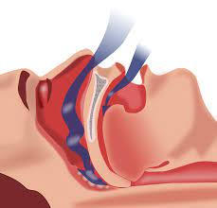
PREVALENCE OF OSA
Approximately 34% and 17% of middle-aged men and women, respectively, meet the diagnostic criteria for OSA.
Sleep disturbances are common and underdiagnosed among middle-aged and older adults, and the prevalence varies by race/ethnicity, sex, and obesity status.
OSA prevalence is as high as 40% to 80% in patients with hypertension, heart failure, coronary artery disease, pulmonary hypertension, atrial fibrillation, and stroke.
OSA is often under-recognized and under treated
https://www.acc.org/latest-in-cardiology/ten-points-to-remember/2021/06/25/15/07/obstructive-sleep-
apnea-and-cvd
Obstructive Sleep Apnea and CardiovascularDisease: A Scientific Statement From the American Heart
Association. Circulation 2021;Jun 21:

Slide 7
CURRENT challenges to managing sdb patient
AHI focused, rather than healthy breathing and sleepiness.
Reimbursement rules drive compliance assessment. If a patient is categorized as compliant, then are we done. ?
What is the definition of compliance for OAT? What happens if you are compliant and not sleeping well?
Selecting the proper appliance.
Side Effects of OAT
CPAP Recall/Supply chain issues
Educating the Patient/Caregiver
Notes:
So focused on lowering the AHI we sometimes lose sight of how the patient is breathing. Beneficial to the pt. Have you serve dthe pt.

Slide 8
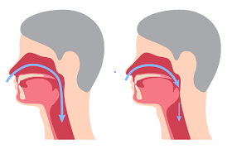
IT IS THE
SLEEP
BETTER BREATHING
BETTER SLEEP
Review diagnosis /Treatment Options
Proper Sleep Hygiene
Promote Nasal Breathing
Tape to seal the lips/ Nasal Mutes/Rubber bands
Titration of the appliance
Managing your patients:
Sleeping and breathing better
IT IS NOT ALL ABOUT THE AHI
Notes:
Work with patients, Concept of the oral appliance- keep lips sealed, Nasal breathing-nasal mutes, nasal examination-tur-bi-nit,deviated septum-,polyps,refer to ENT, rubber bands for mouth closure and stabilization of the mandible

Slide 9
LOW AHI/COMPLIANT/
STILL SLEEPY
Severity of Subjective Symptoms
Overlap Of SBD
Residual Sleepiness (RES)
Medications
Manage Symptoms
Managing your Patients
Patient still has excessive daytime sleepiness after continuous positive airway pressure (CPAP) treatment of OSA, comorbid conditions or permanent brain injury before CPAP therapy may be the cause of the residual sleepiness
Stradling JR. Residual sleepiness in patients with OSA on CPAP.Eur Respir J 2009; 34:120
Chapman JL, Serinel Y, Marshall NS, Grunstein RR. Residual Daytime Sleepiness in Obstructive Sleep Apnea After Continuous Positive Airway Pressure Optimization: Causes and Management. Sleep Med Clin. 2016 Sep;11(3):353-63. doi: 10.1016/j.jsmc.2016.05.005. Epub 2016 Jun 16. PMID: 27542881.
Notes:
Sleepiness is subjective…re zi dual, Goal is to manage pt AHI from 6-4, and manage symptoms as well. If a pt has an AHI of 48( which is (bad) and another pt has an AHI of 98---longer events ..more important to manage and observe and treat symptoms

Slide 10
We enter the World Inhaling…
We leave the world Exhaling…
BETTER BREATHING = BETTER HEALTH
Educate patients on breathing techniques
Nasal breathing is better
Stimulate the Parasympathetic Nerve System (Vagus Nerve)
Psychological Factors
Andre, Christiopher,et al,ProperBreathing Brings Better Health, Wellness, 1-16, 2019, January 15
Notes:
Yoga, several breathing techniques helps with sleep, insomnia,Vagus Nerve. When the vagus nerve is stimulated t by slow breathing his calmness pervades the body, slow heart rate , lowers blood pressure,Neurological and phychiological mechanisms

Slide 11
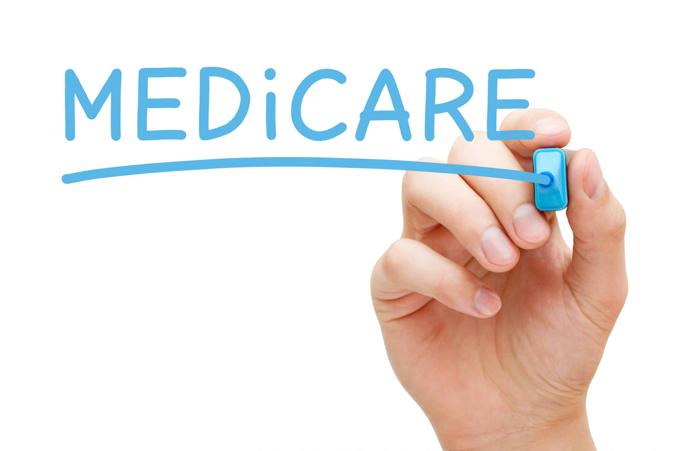
REIMBURSEMENT
CPAP compliance is noted : 4 hours/for four nights/week 'Minimum of 21 nights in a 30-day period”
This is the requirement set by Medicare
Oral Appliances – Compliance is high
GUIDELINES

Slide 12
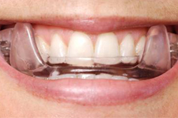
COMPLIANCE
Equivalent to a CPAP
Wearable
What is the prescribed number of hours?
HOW IS IT MEASURED
for
OSA?
The DEFINTION of Compliance for a CPAP has been
‘a minimum of four hours of use per night and a
Minimum of 21 nights in a 30 day period”
Notes:
Equivalent to a CPAP . CPAP provides data..performance of the machine and the pts compliance. Have the pt get a wearable…compliantry reports wearable device

Slide 13
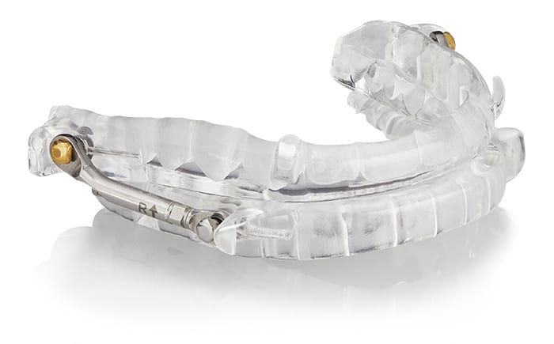
DIFFERENT PATIENTS
DIFFERENT APPLIANCES
Dentists should be familiar with all types of Appliances
Complete Oral and Dental Anatomy Exam: Soft tissue and Hard tissue
Listen to patient
Patient's ability to titrate appliance
Medical Insurance may dictate
Medicare Approved Appliances:
ProSomnus PH Appliance (Herbst)
Glidewell Oasys Hinge Appliance(Herbst)
DreamTAP
SomnoMed Herbst
Respire Herbst

Slide 14
DESIGNS and Mechanisms OF APPLIANCES
Four Categories: Attached: Midline Traction, Bilateral Compression, Bilateral Traction, Unattached: Bilateral Interlocking
Propulsion: Traction/ Compressive Forces…Maxillary Arch is the stationary arch
Missing teeth, Retention, Tongue size, Gag reflex, Undercuts present, Bruxer, Tongue habit, Short Clinical crowns, claustrophobic, tori, exostoses, mouth breather,
Medical Insurance dictates
Titration methods : Dexterity and vision to adjust
DESIGNS AND MECHANISMS OF APPLIANCES
Notes:
Are anterior teeth present? Are Maxillary Molars present/ Mandibular Molars? Selecting/choosing the proper appliance is major point in managing your pts…Managing patients choosing the proper appliance…Four categories, # Attached and 1 unattached , Propulsion: Consider the maxillary as the stable arch-?
Angle/position for interlocking, Bilateral Traction (pull) examples: Panthera, ADVANT, Missing anterior teeth has fliiper, missing m2 mand molars. Which appliance is best for her ? Bilaterl compression : forces are mesial

Slide 15
Management Considerations of Side Effects
AM Positioner/ Occlusal Guide
Palliative Care: Several options; ice, heat, massage, anti inflammatory, soft diet, and rest
Watchful Waiting: Diligent observing, with documentation in patient’s chart, follow up visits, resolution. Used when risks of treatment are greater than the possible benefits
Journal of Dental Sleep Medicine: Vol. 4, No. 4, 2017 Management of Side Effects of Oral Appliance Therapy for Sleep-Disordered Breathing Rose D. Sheats, DMD1; Thomas G. Schell, DMD2; Alan O. Blanton, DDS3; Patricia M. Braga, DDS4; B. Gail Demko, DMD5; Leslie C. Dort, DDS6; Donald Farquhar, DDS7; Sheri G. Katz, DDS8; Jean-Francois Masse, DMD9; Robert R. Rogers, DMD10; Steven C. Scherr, DDS11; David B. Schwartz, DDS12; Jamison Spencer, DMD, MS13
First Line of Treatment
Second Line of Treatment
Changing appliances
Returning to CPAP

Slide 16
Management of
SIDE EFFECTS of
Oral Appliance Therapy
(OAT)
TMJ Related- Palliative Care-Massage, ice, heat, and exercises…
May have to add stops, to appliance, change appliances, steroids, a through TMJ exam
Soft tissue/Gingiva/ Tongue Irritations: Recontour appliance, sharp areas. Discontinue Appliance- Second line of treatment
Excessive Saliva: Generally benign subsides in a few days, weeks. Initial Care conservative. Modification to appliance, decreasing VDO
Dry Mouth: Benign, as well. Initial conservative care. Medications, Seal lips with tape
Occlusal Changes: Decreased Overjet/Overbite ,Incisors Change, Watchful waiting…Modification of appliance
Gagging: Reduce bulk, desensitization techniques
Educate and inform patients/caregivers
On possible side effects before
Treatment begins…
Proper Selection of an Appliance is so IMPORTANT!
Notes:
Palliative Care: Several options; ice, heat, massage , anti inflammatory, soft diet restful Watchful Waiting: Diligent observing, with documentation in patient’s chart, follow up visits, resolution. Used when risks of treatment are greater than the possible benefits

Slide 17
Educating Patient/ Caregiver
Lifestyle Changes…weight loss, smoking, alcohol, exercising
Knowing Body Position and Positional OSA
Educate patients on proper breathing
Encourage nasal breathing
Different treatment options for OSA are available
J Clin Sleep Med . 2015 Feb 15; 11(2): 131–137. Published online 2015 Feb 15. doi: 10.5664/jcsm.4458 Usage of Positional Therapy in Adults with Obstructive Sleep Apnea Grietje E. de Vries, MSc, Aarnoud Hoekema, MD, PhD, Michiel H.J. Doff, DMD, PhD, Huib A.M. Kerstjens,MD, PhD, Petra M. Meijer, NP, Johannes H. van der Hoeven, MD, PhD, and Peter J. Wijkstra, MD,PhD
Chest 2005 Oct;128(4):2130-7. doi: 10.1378/chest.128.4.2130. Prevalence of positional sleep apnea in patients undergoing polysomnography M Jeffery Mador , Thomas J Kufel, Ulysses J Magalang, S Kajesh, Veena Watwe, Brydon J B Grant
PRIMARY OBJECTIVE
ACHIEVE APPLIANCE SUCCESS AND EFFICACIOUS TREATMENT
Notes:
Ef fiacay cious. POSA is defined as an AHI at least twice as high while sleeping in the supine position as in other positions. With regards to prevalence of POSA, if we use the definition of AHI>5 there is a 50% reduction when the sleep posture in non supine, we see 49.5% of patient.

Slide 18
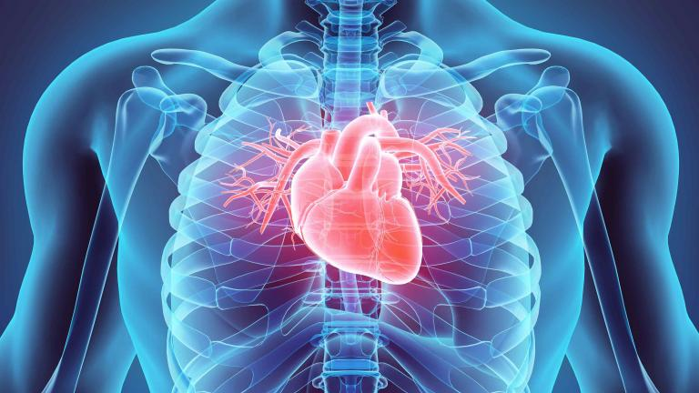
Education leads to better adherence
Emphasizing the health consequences of untreated OSA, and addressing the concerns of patient’s bed partners may increase adherence with oral appliances

Slide 19


CPAP RECALL AND CHIP/SUPPLY CHAIN ISSUES
Phillips has an enormous recall effecting 3- 4 million people
Res Med filling the orders due to a supply chain issue shortage of chips
Notes:
Phillips has an enormous recall effecting 3- 4 million people, and Res Med filling te order due to a supplu chain issue shortage of chips

Slide 20
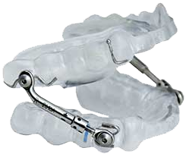
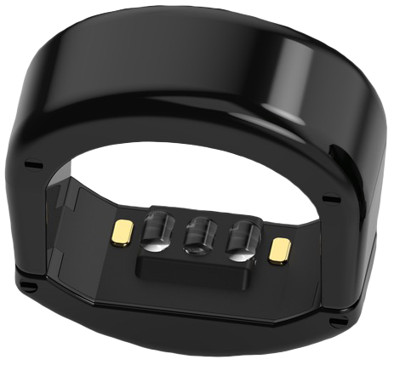
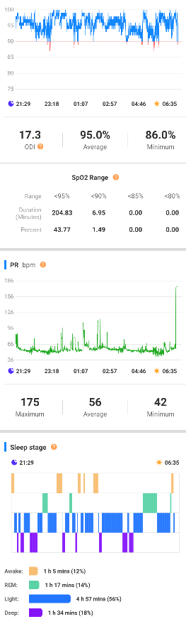
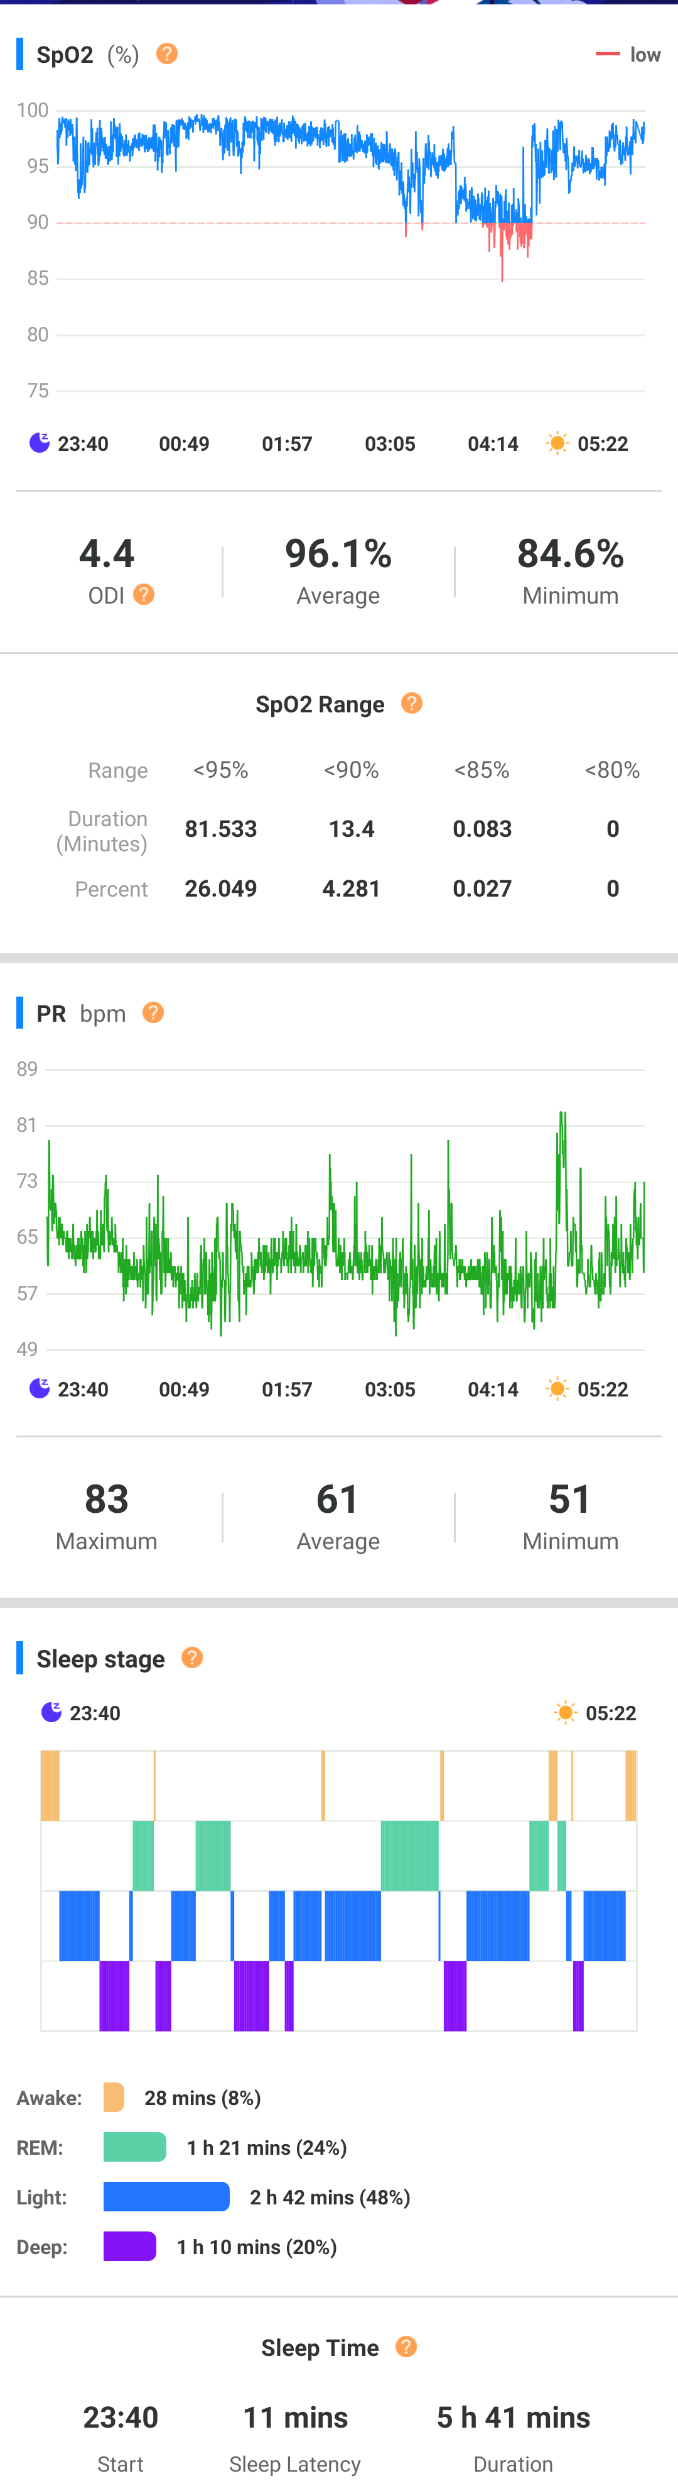
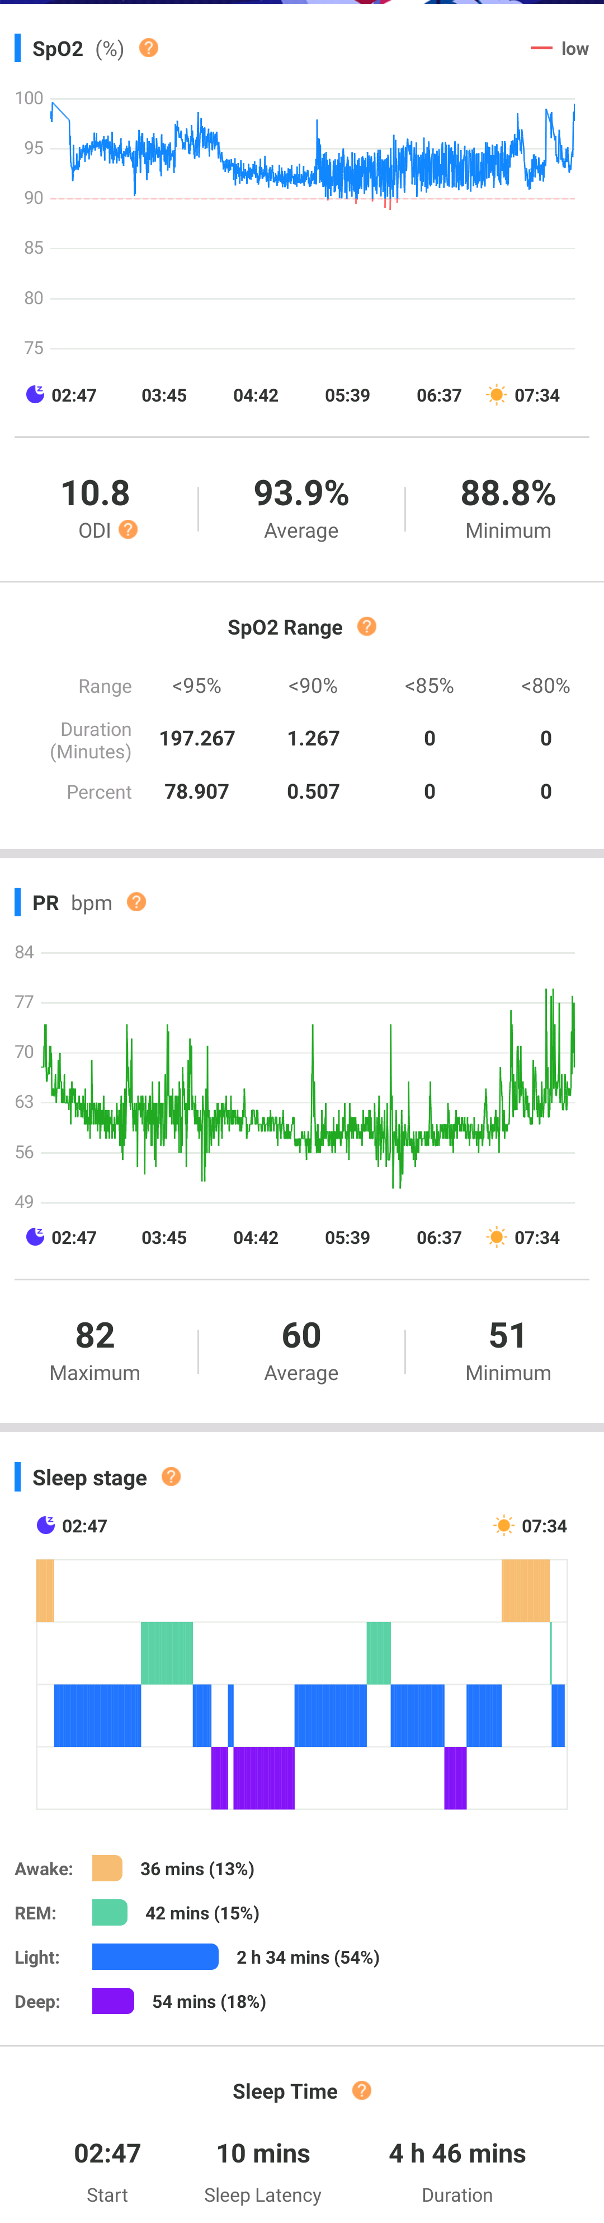
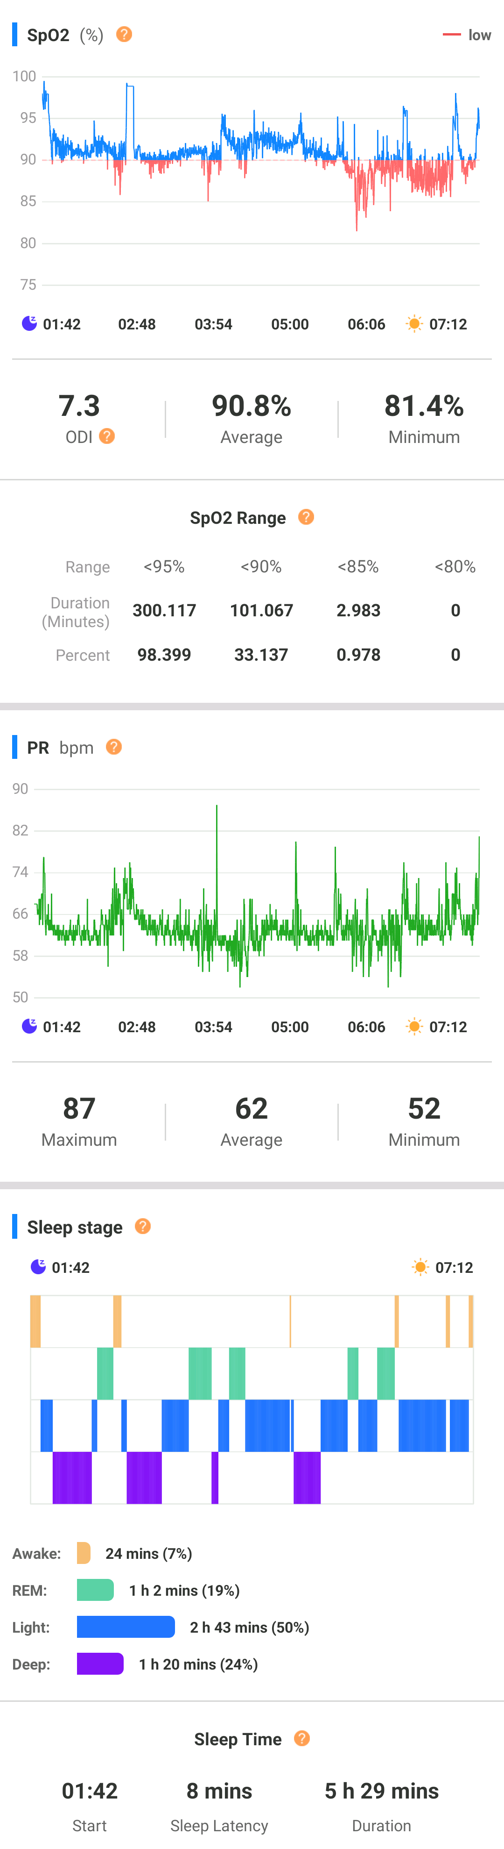
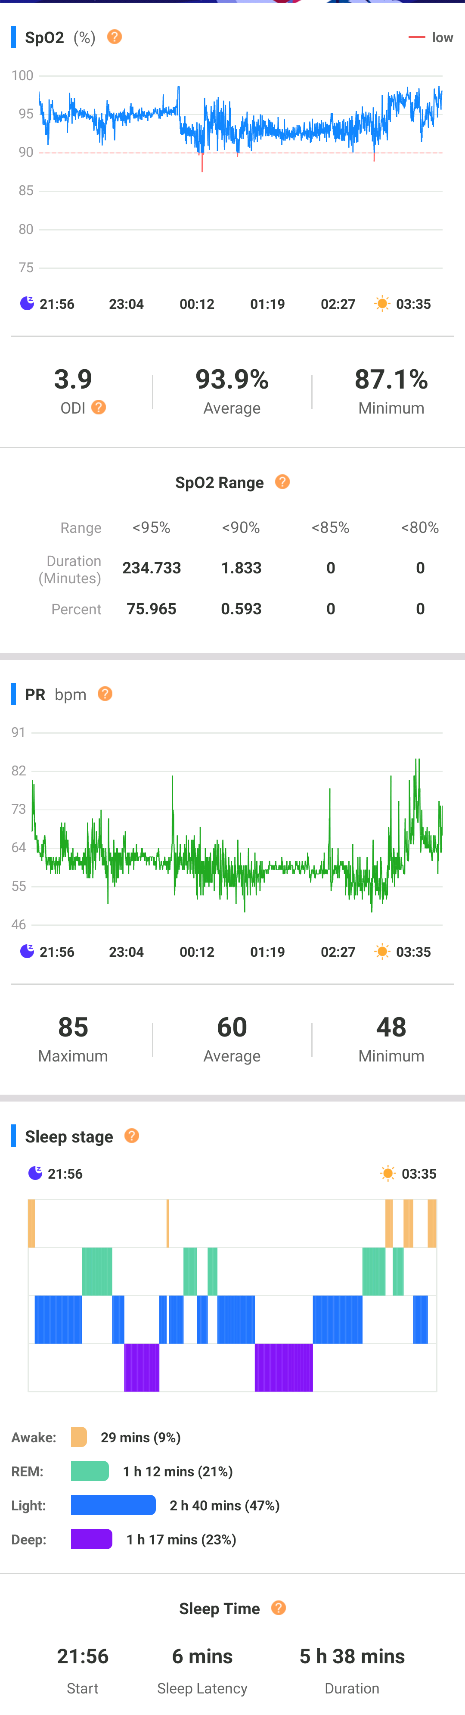
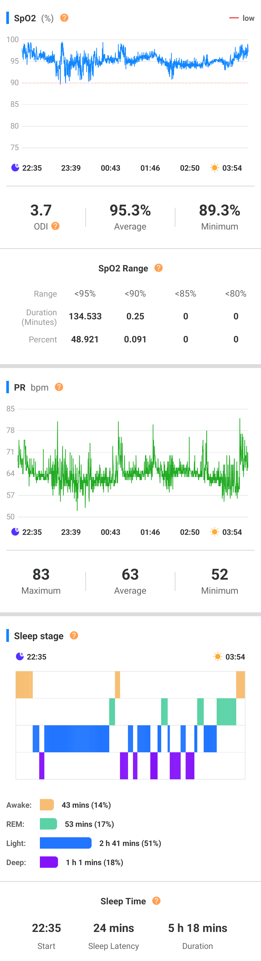
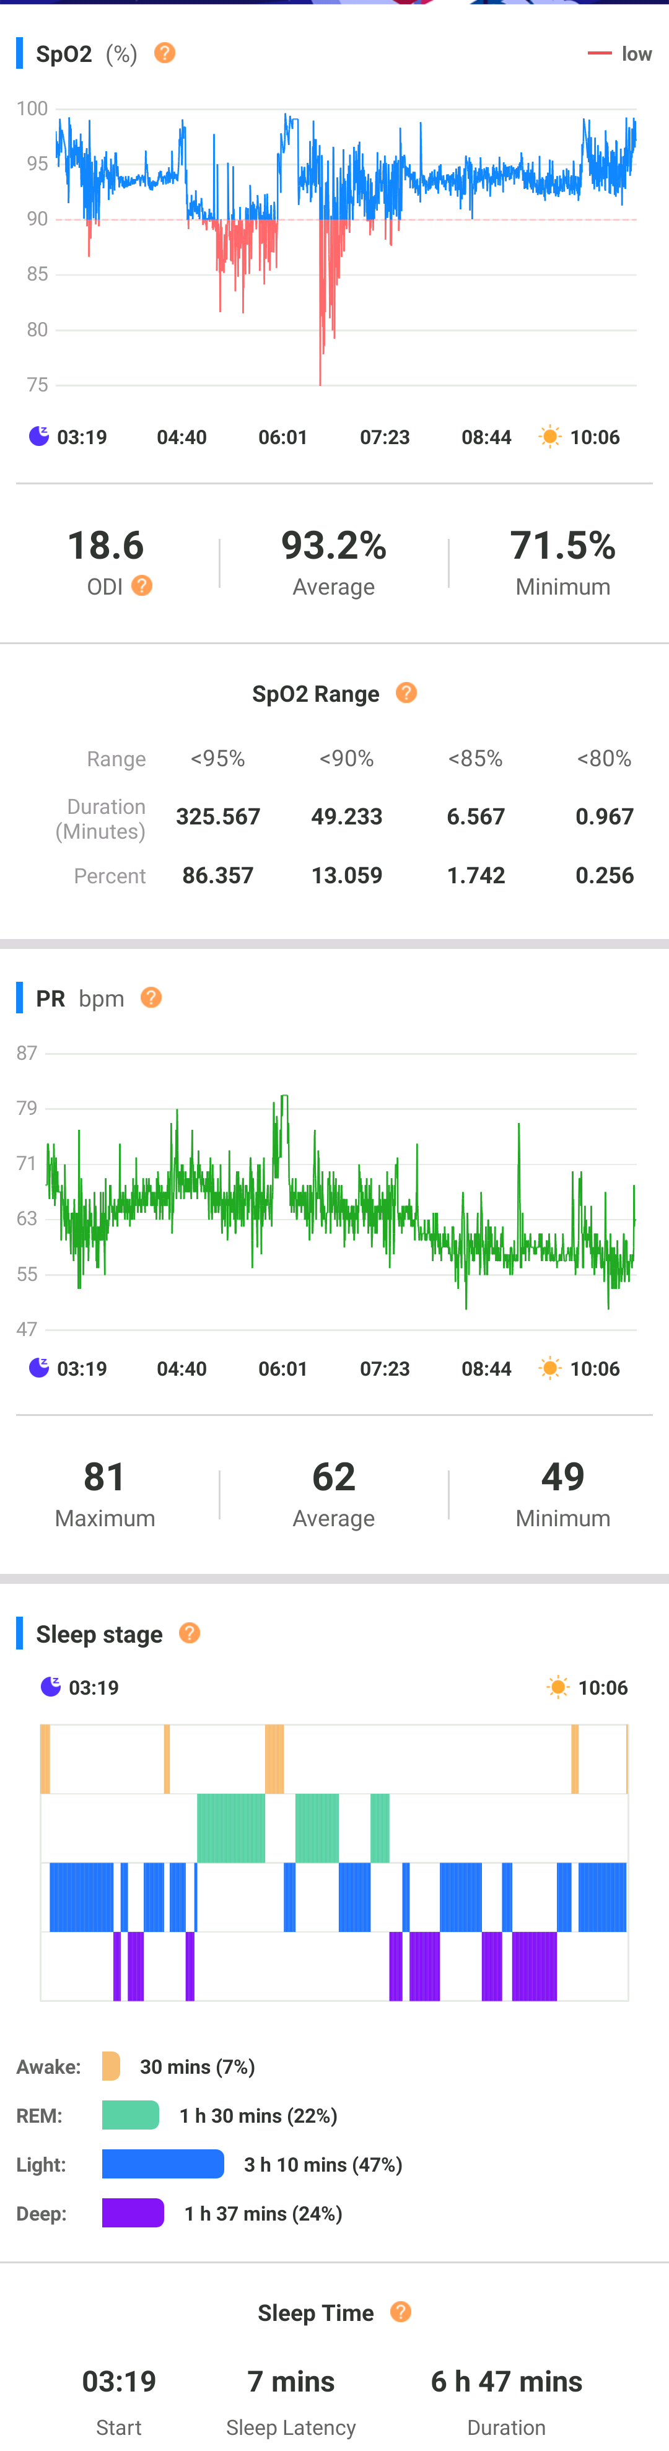
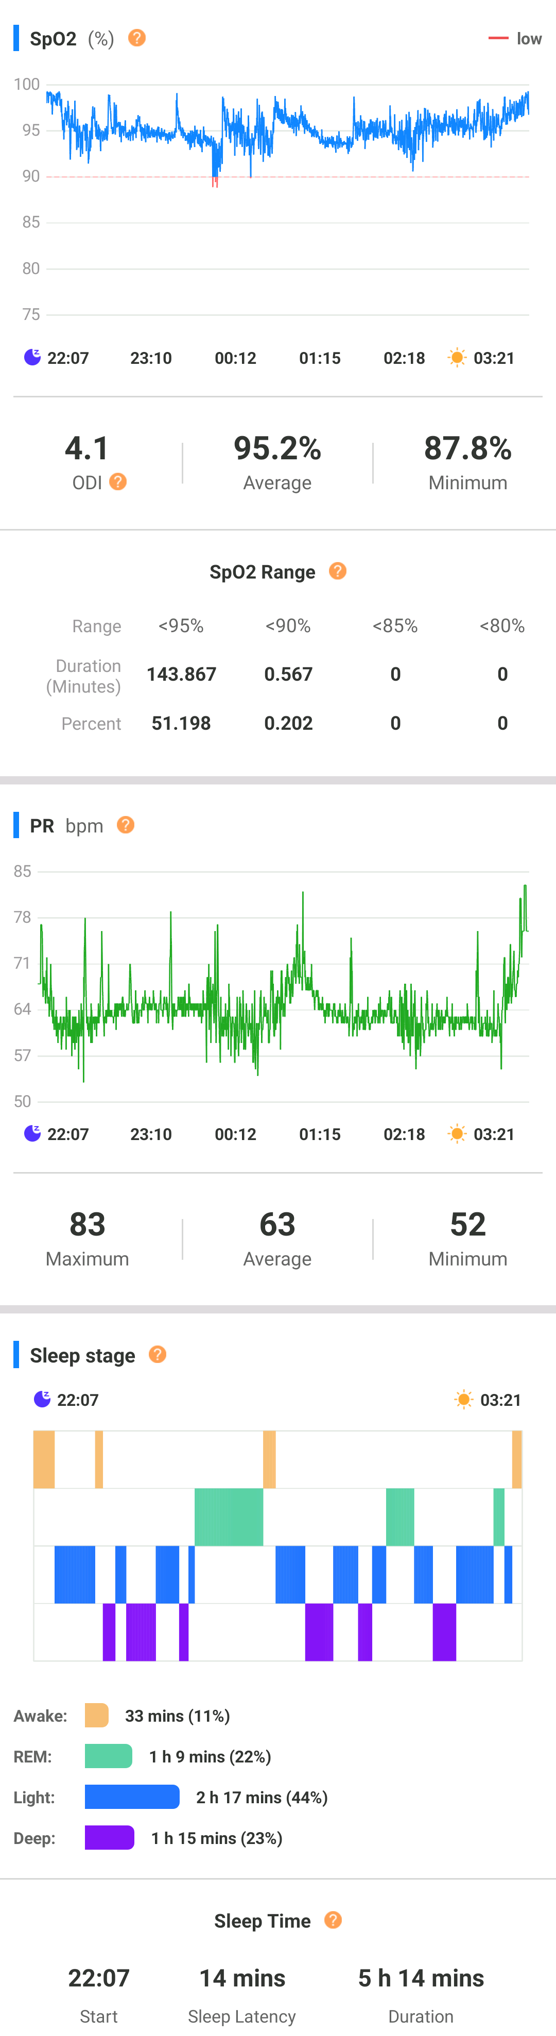
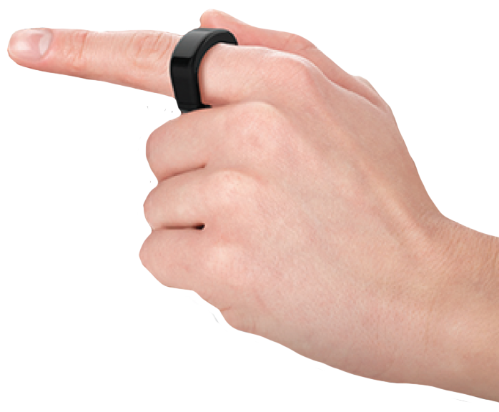
TRACK PROGRESS
Used for Titration
Very high clinical yield
Engages Patients – invested in improved sleep
Measure progress over time, every day for a month
Measures Efficacy
Wearable, not a
diagnostic instrument
Notes:
Tracking efficacy of an appliance

Slide 21
FOLLOW UP VISITS
FOLLOWING APPLIANCE DELIVERY
CHANGES:
Health History/Medications
Weight
AHI /Efficacy
Symptoms: Daytime sleepiness, snoring, etc.,
One Month
Four months
Six months
Annually
SEE PATIENT
ONCE /ANNUALLY
Notes:
Weight loss : 10% of weight loss to lower AHI(26%) Weight gain of 32% to increase AHI

Slide 22
Managing the SBD
Patient
Optimal fit of the appliance
Adjusted over time for effectiveness
Subjective/Objective Changes in Patients
Long term treatment Success
ENSURES…

Slide 23
Time to Harmonize
CPAP
APPLIANCES
Efficacy higher, Compliance lower
Poor tolerance, Low Patient acceptance
AHI Improved
AHI < 10/events is 2X greater
Efficacy lower, Compliance higher
>80% after one year
Comfortable
Portable
COMBINATION THERAPY
Ramar K, Dort LC, Katz SG, et al. Clinical Practice Guideline for the Treatment Obstructive Sleep Apnea and Snoring with Oral Appliance Therapy: A Update for 2015. Journal of Clinical Sleep Medicine. 2015; 11(7): p. 773-827.
Sutherland K,, Dalci O, Cistulli P, et al. SleepMedical Clinic. 2021Mar: 16(1):145-154, doi: 10.1016/j.jsmc.2020.10.004. Epub 2020 Dec 7.
Notes:
Achieving an AHI < 10 events/hr is tow times greater with CPAP than OAT, although adherence with OA is better overall. EVIDENCE BASED Fiveash… story…better CPAP , Appliances, Combination therapy. Reduce pressure on CPAP with appliance…best of both worlds

Slide 24
Takeaways
Educate your patient/caregiver
Team education and support is a MUST
Major reason for discontinuation of appliances- Patients perceived benefits
Look beyond the AHI
Obstructive Sleep Apnea (OSA) is a common chronic disorder that requires lifetime care and management of the patient
Notes:
Excess saliva, dry mouth, TMJ soreness, Gingiva /teeth soreness

Slide 25

I WISH YOU AND ALL
OF YOUR
PATIENTS
SWEET DREAMS!
Dr. Suzanne Mericle
Mericle Dentistry/St. Simons Dental Sleep &TMJ Center
Practical Sleep Education
ASBA Diplomate
ASDSM Qualifying Dentist
Drmericle.mericledentistry@gmail.com
Office: 912.638.3559
Cell: 912.230.4039
123 Main Street, Saint Simons Island, Georgia 31522

